Slide 1

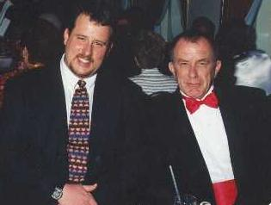
Exposure CS 2021
for CS1
Chapter 6 Section 4-8 Slides
More Python Libraries:
Graphics Library Procedures
PowerPoint Presentation
created by:
Mr. John L. M. Schram
and Mr. Leon Schram
Authors of Exposure
Computer Science

Slide 2
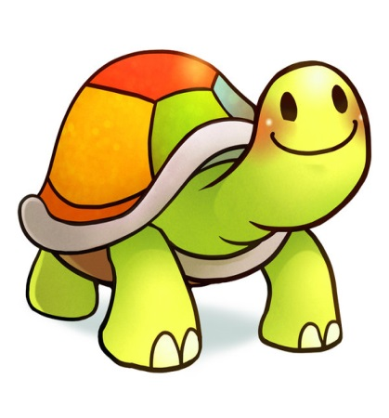
Section 6.4
Introduction to Graphics
without the Turtle

Slide 3
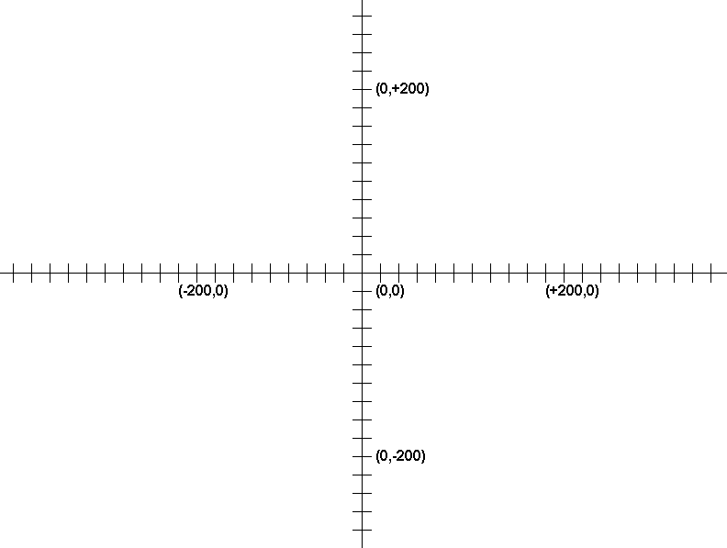
Cartesian Coordinate Grid

Slide 4
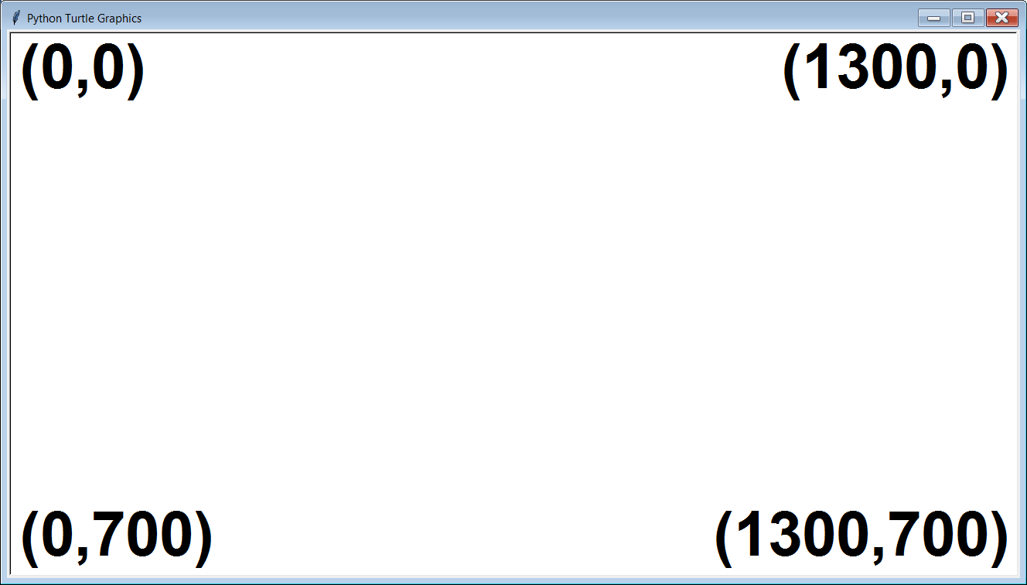
Typical Computer Graphics Window

Slide 5
Typical Computer Graphics Window
NOTE:
The “origin”
is in the top-
left corner.

Slide 6

Python “Traditional Graphics” Disclaimer
There actually is an interface called tkinter that can be used with Python to create graphics output with the traditional coordinate-based system, but that requires some knowledge of Object Oriented Programming, which is a topic that is beyond the scope of this first year Computer Science class.
“OOP” is actually a major component of AP® Computer Science-A, which some of you might be taking next year.

Slide 7
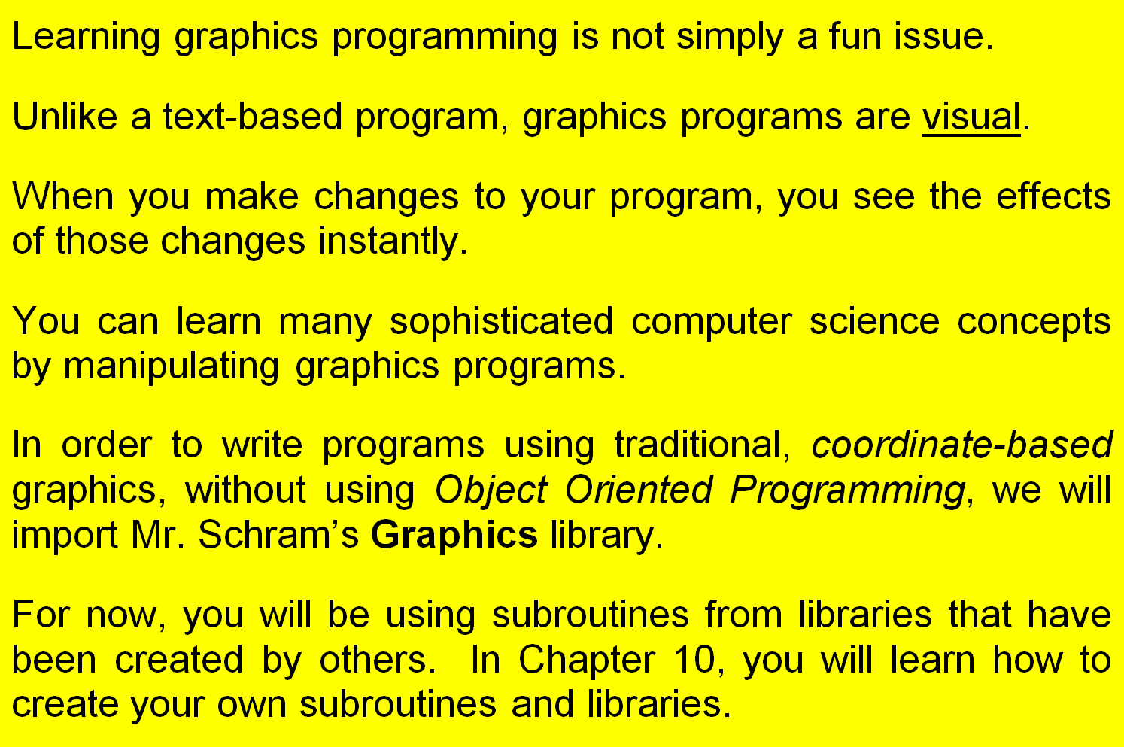
Learning Graphics Programming in IntroCS
In Chapter 9, you will learn how to

Slide 8
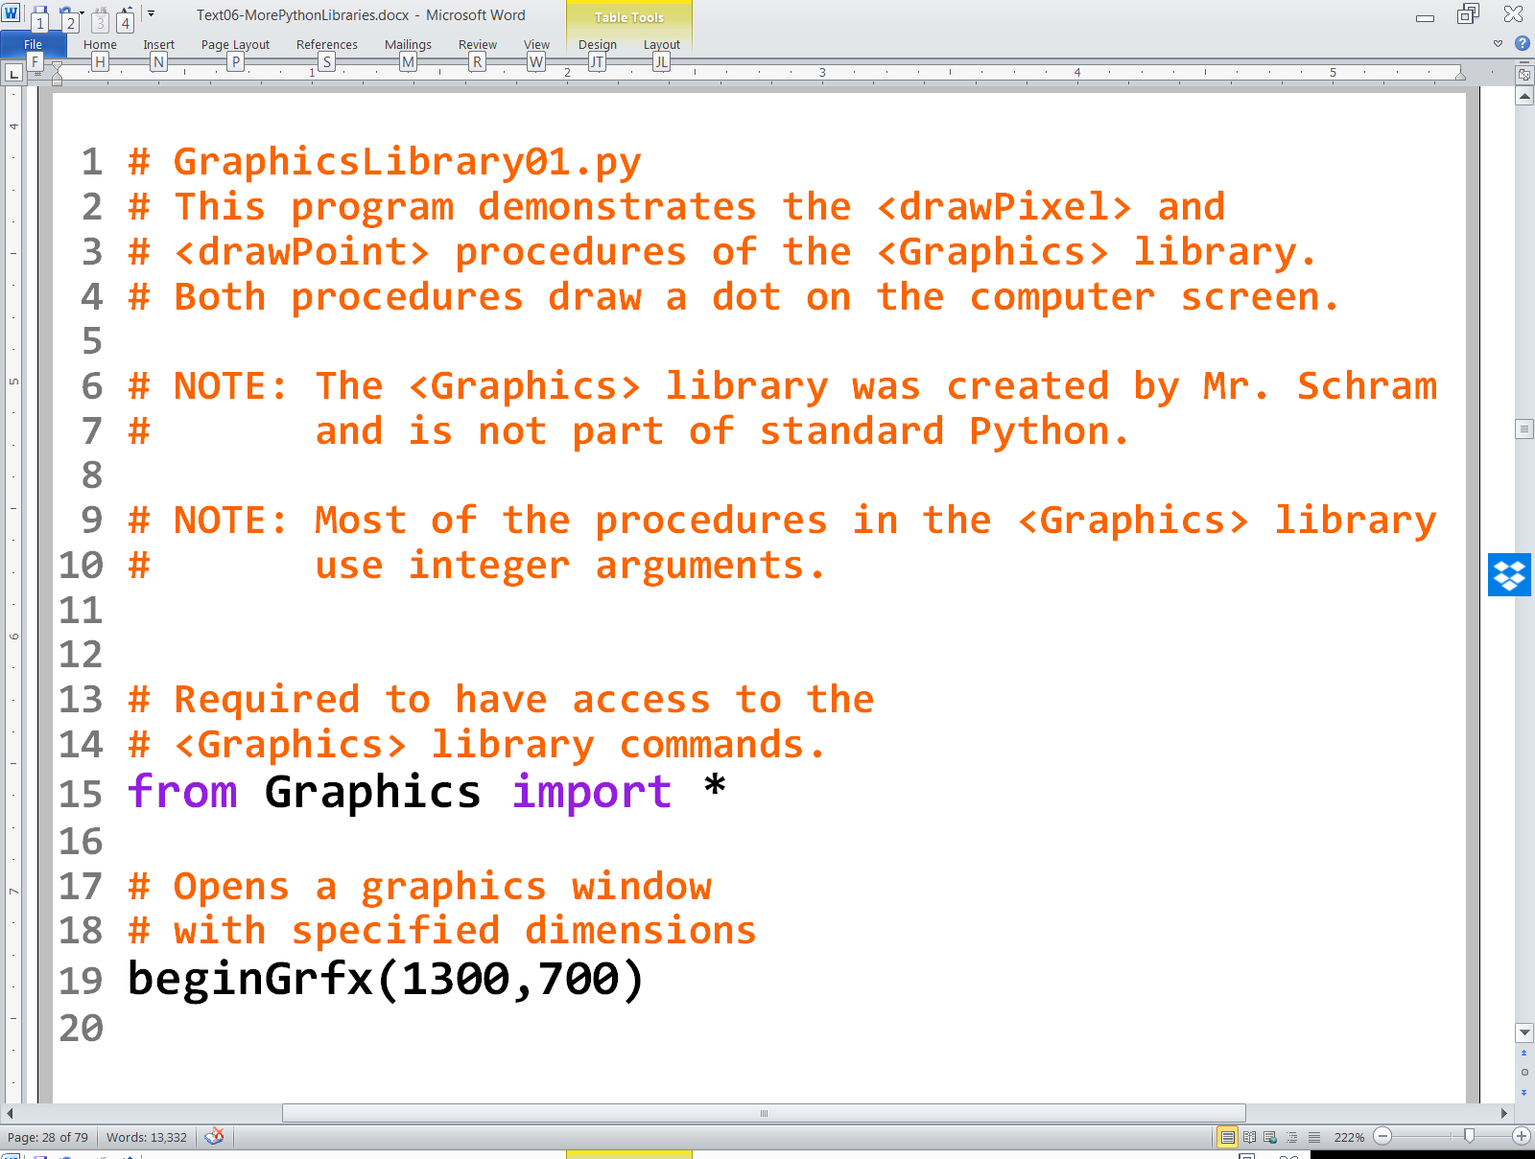

Slide 9
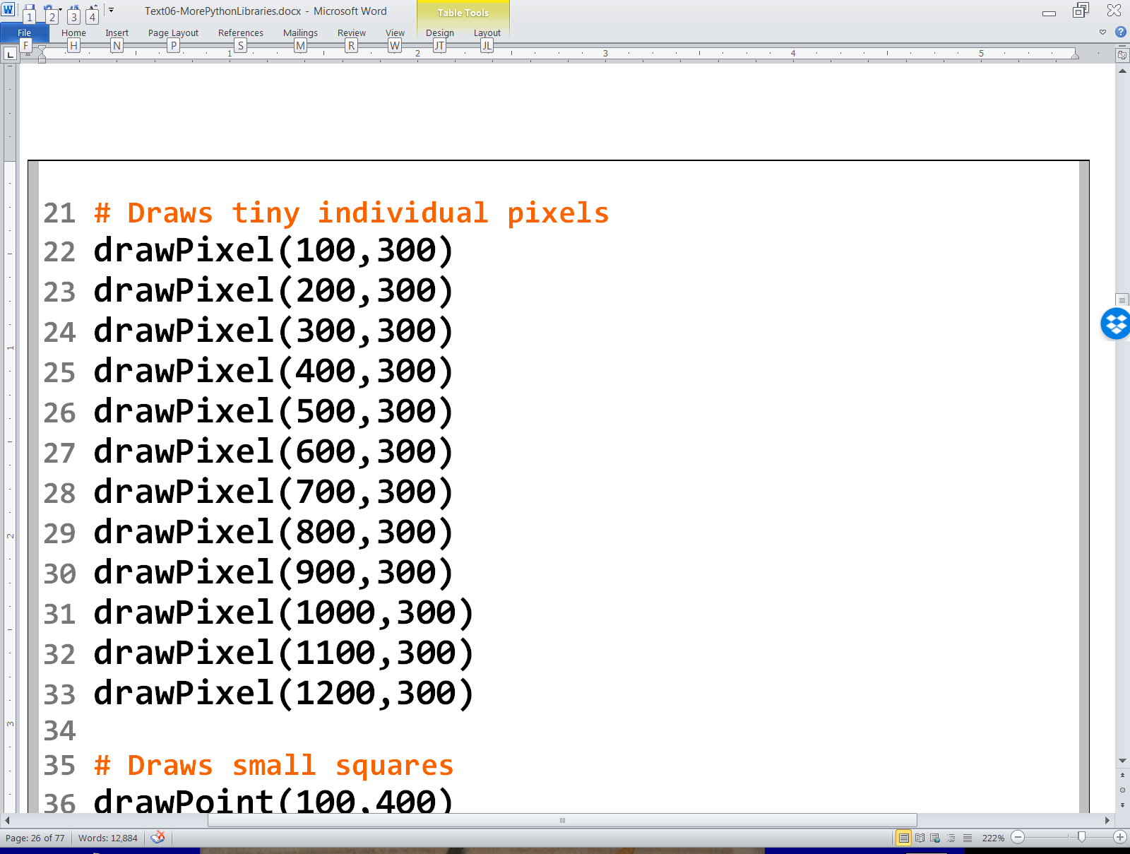
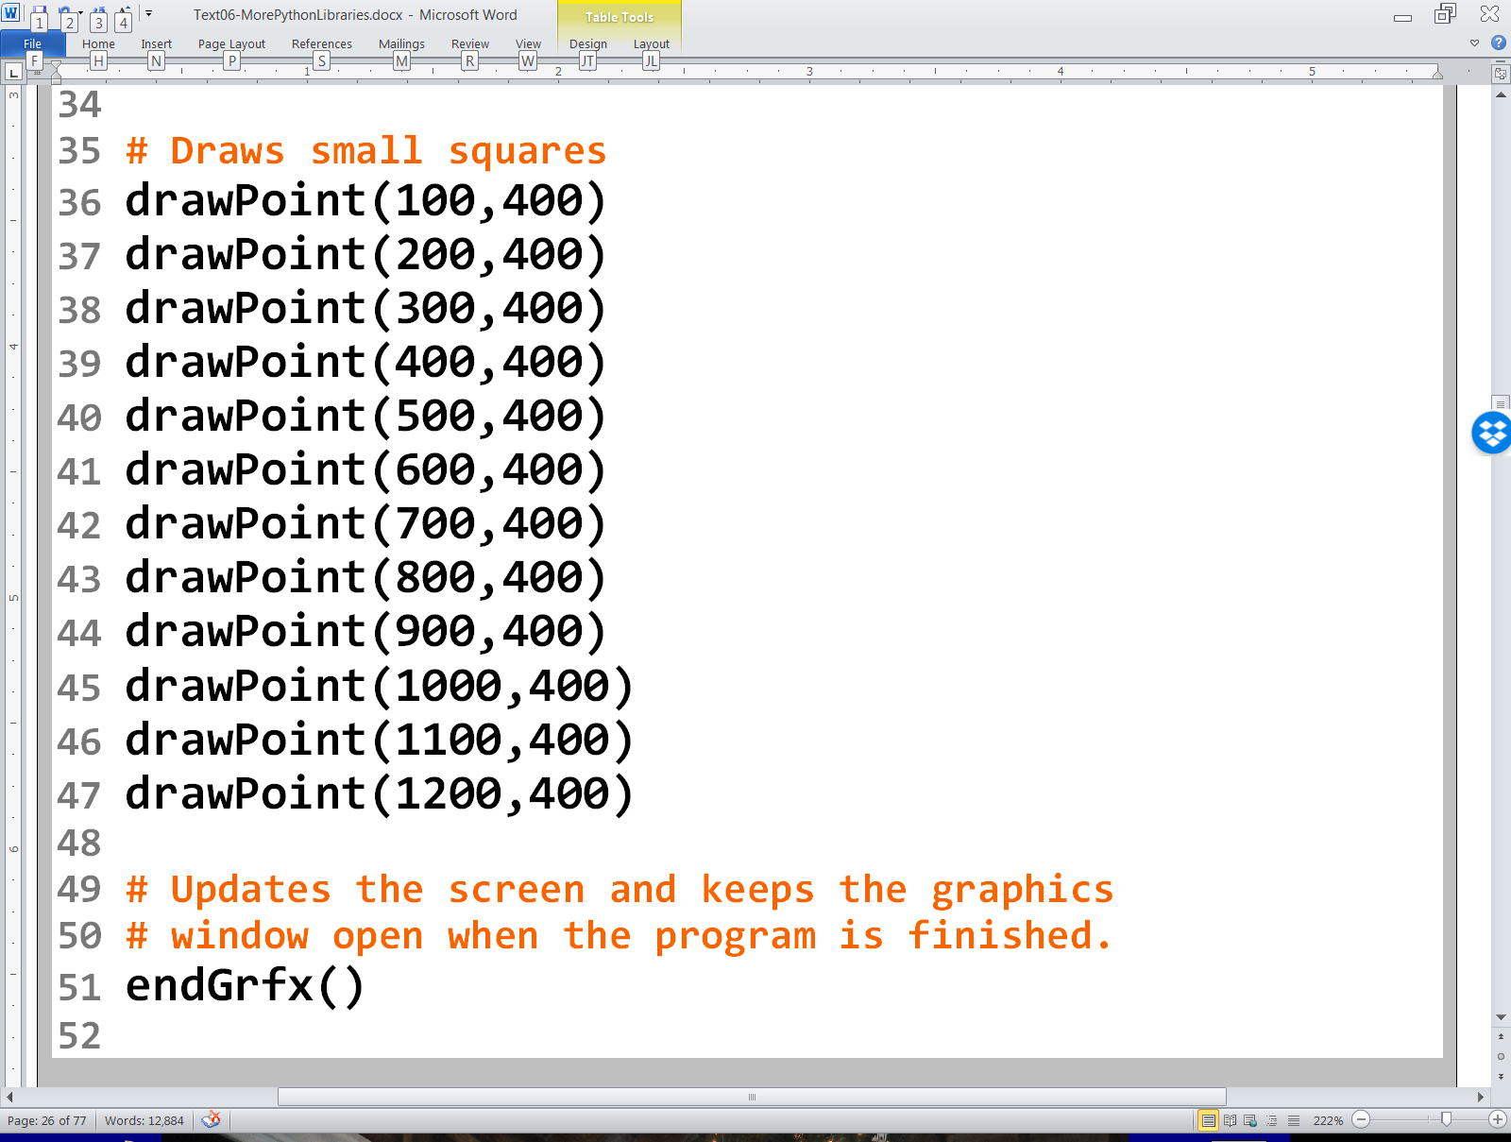

Slide 10
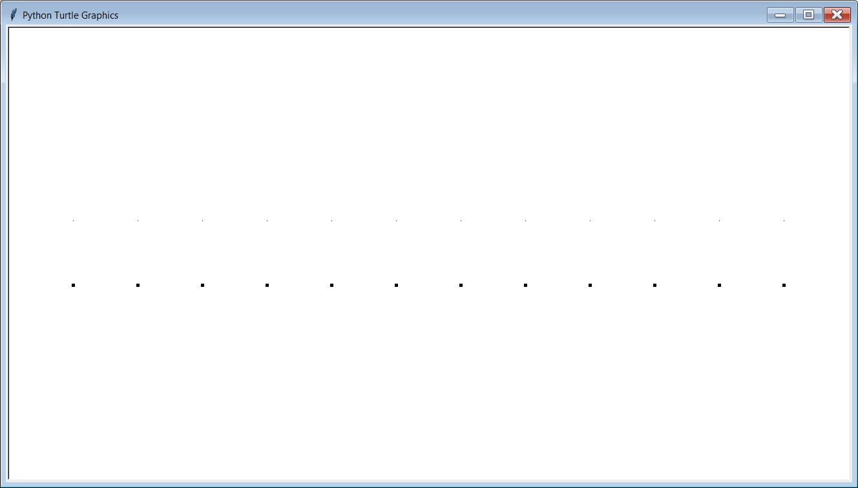
GraphicsLibrary01.py Output The pixels may be difficult to see.

Slide 11
GraphicsLibrary01.py Output The pixels may be difficult to see.

Slide 12
Section 6.5
Drawing
Simple Shapes

Slide 13
Procedure drawLine
drawLine(x1, y1, x2, y2)
Draws a line from coordinate (x1,y1) to coordinate (x2,y2)
x1, y1
x2, y2

Slide 14
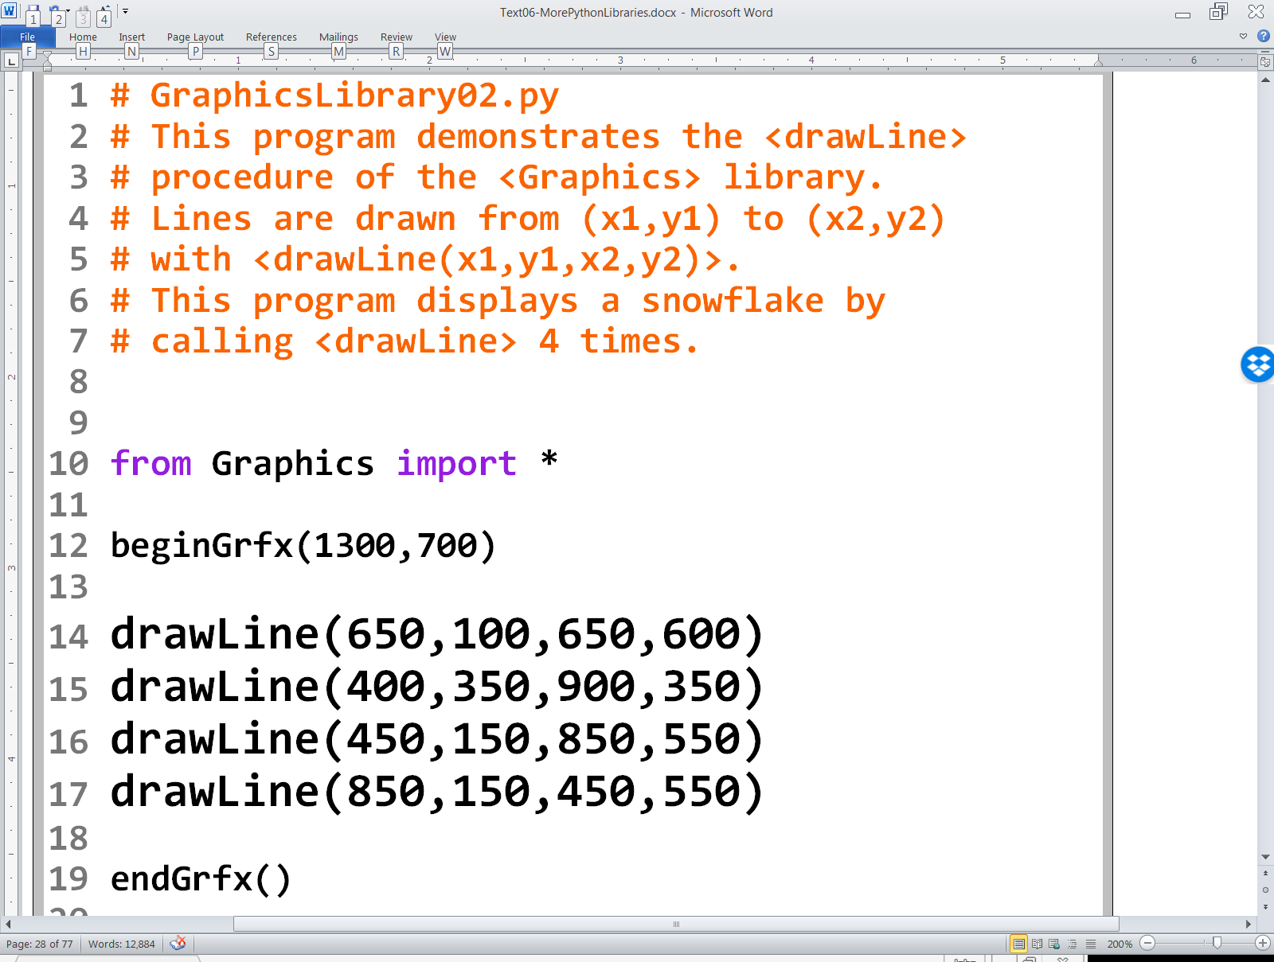

Slide 15
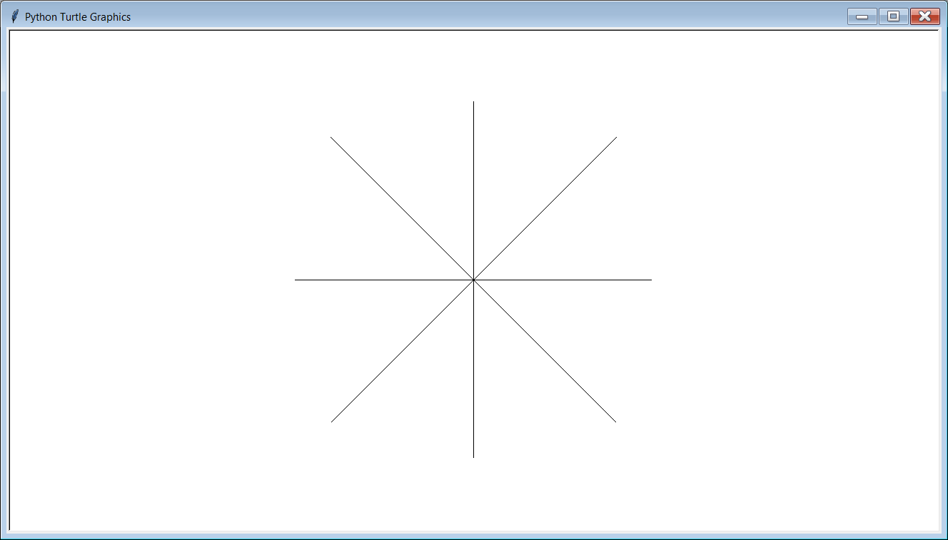

Slide 16
Procedure drawRectangle
drawRectangle(x1, y1, x2, y2)
Draws a rectangle with a top-left corner at coordinate (x1,y1) and a bottom-right hand corner of (x2,y2).
x1, y1
x2, y2

Slide 17
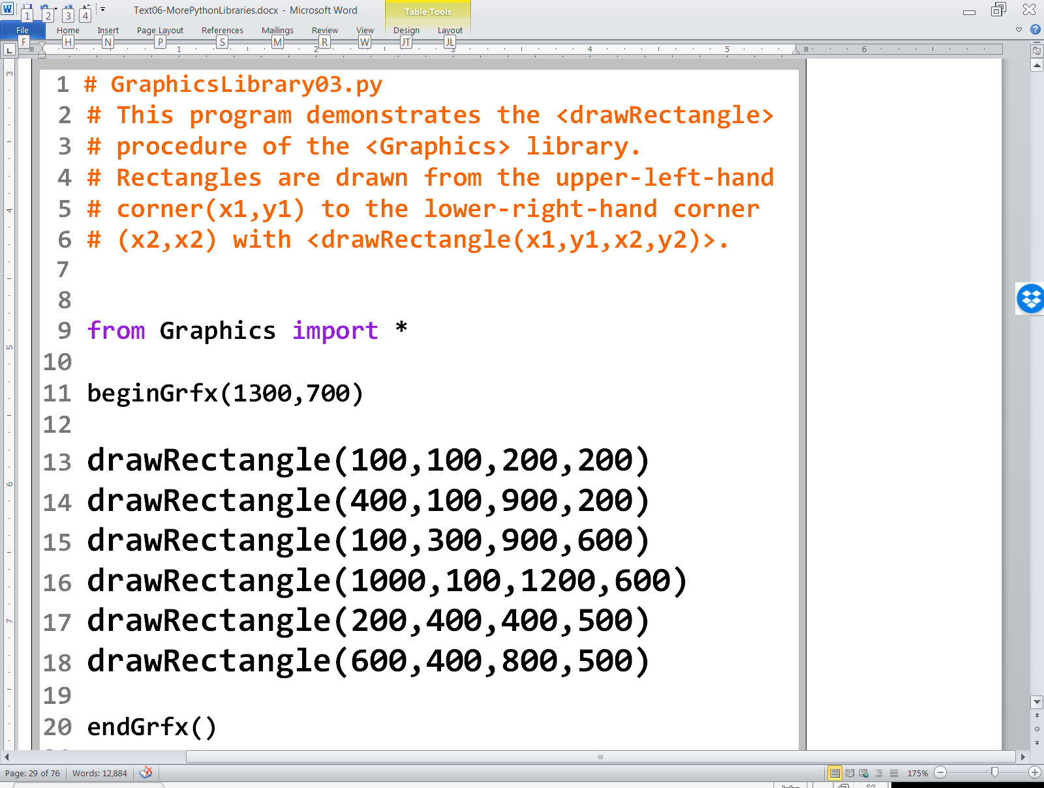

Slide 18
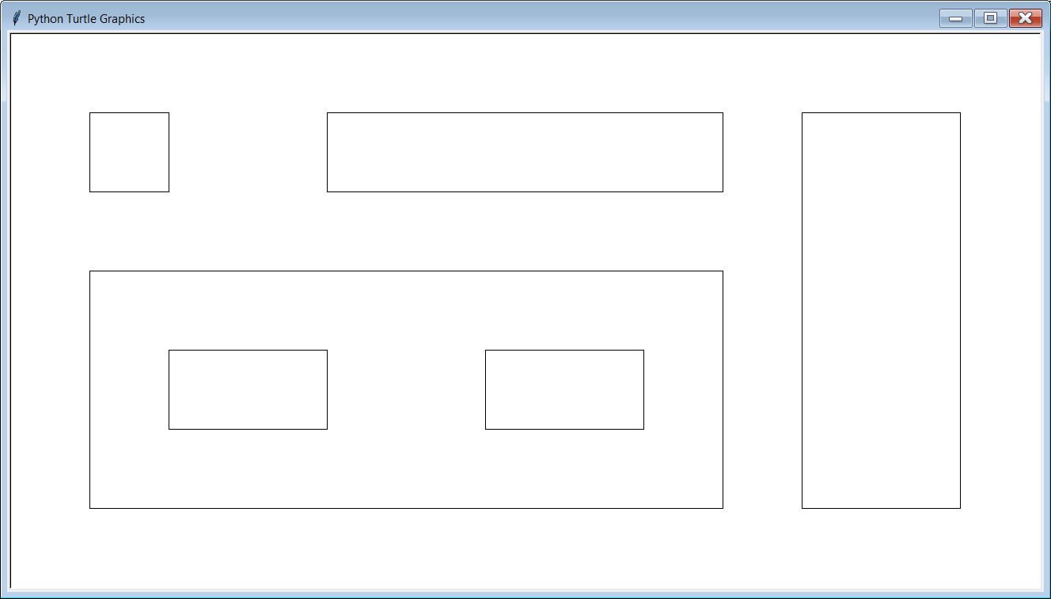

Slide 19
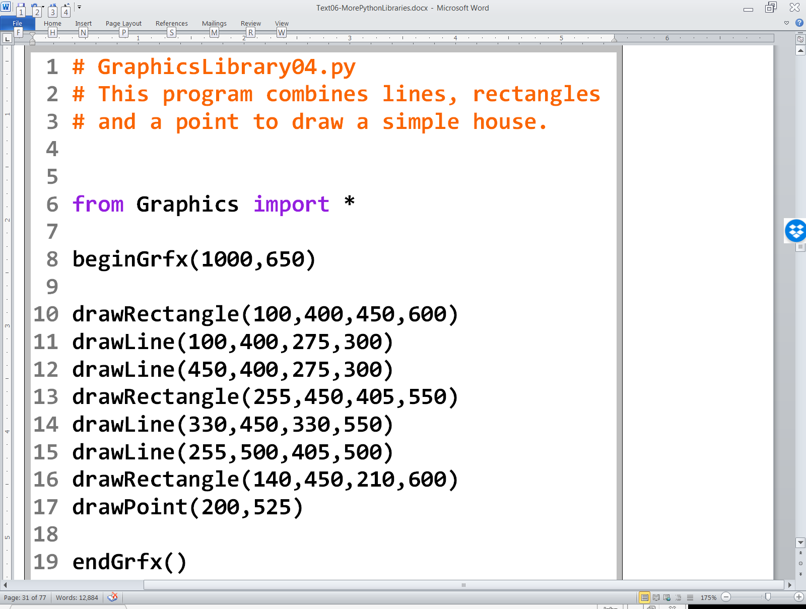

Slide 20
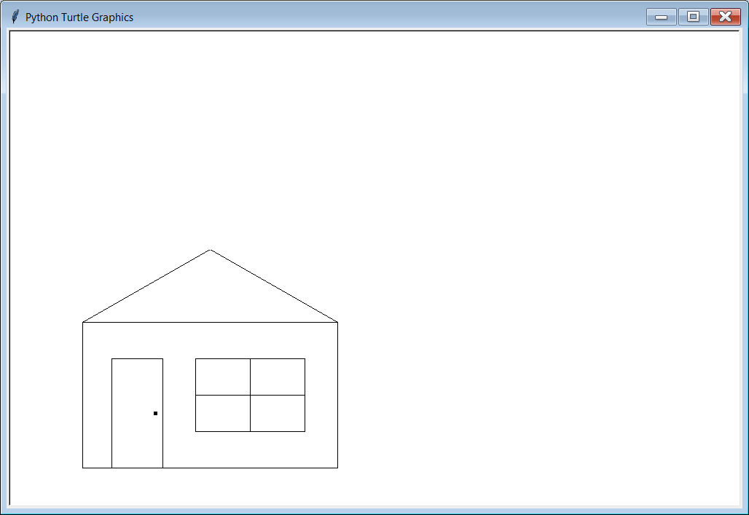

Slide 21
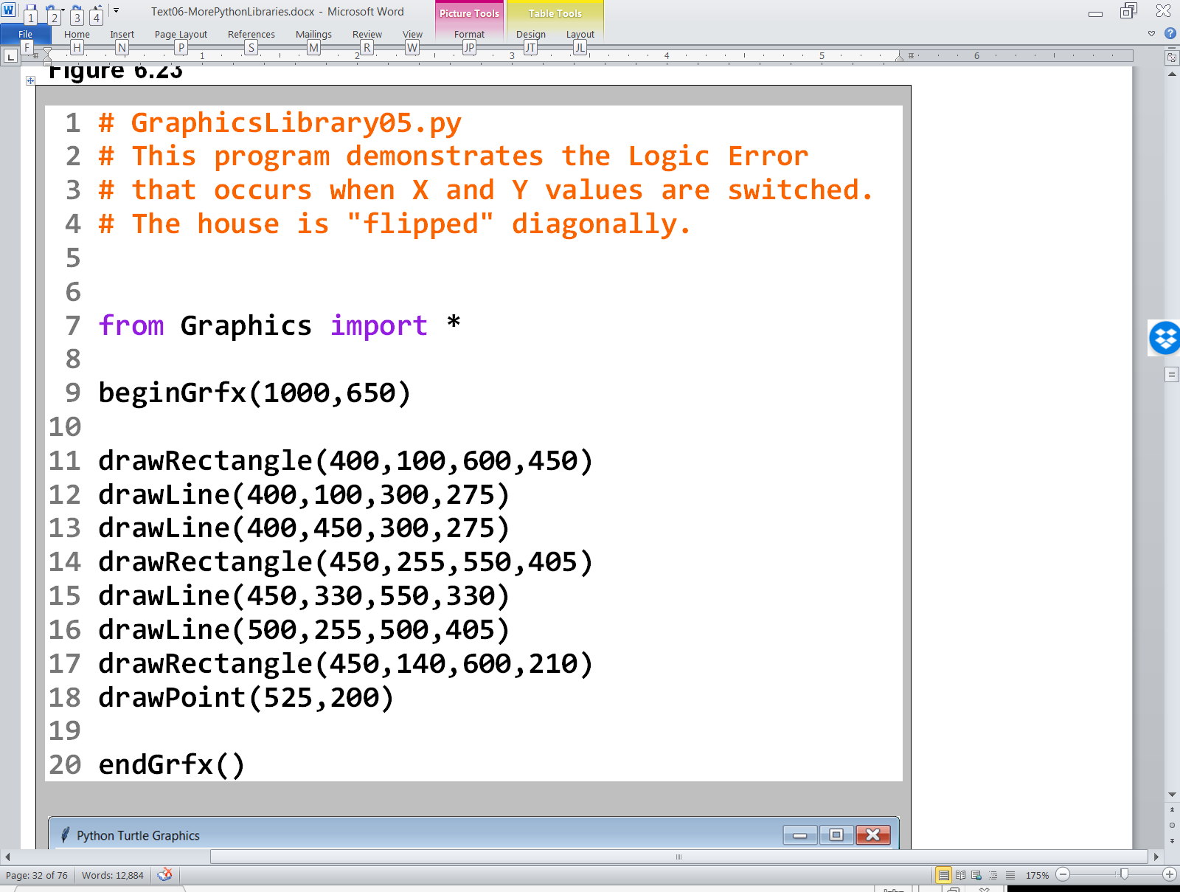

Slide 22
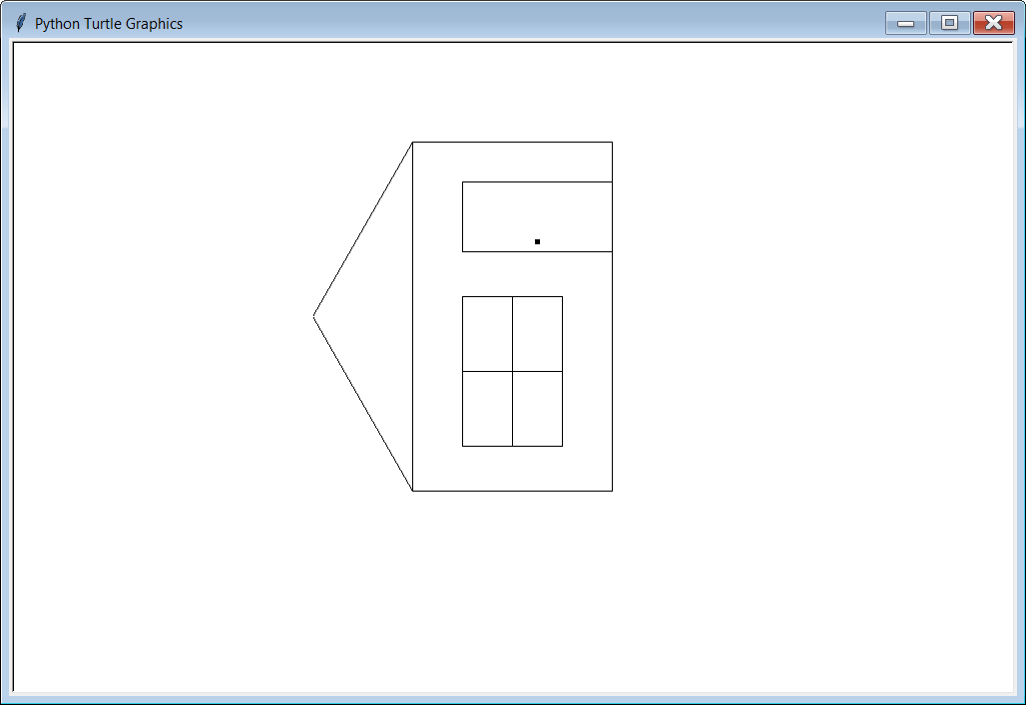

Slide 23
Argument Sequence Matters GraphicsLibrary04.py vs. GraphicsLibrary05.py

Slide 24
Procedure drawCircle
drawCircle(centerX, centerY, radius)
The location of the circle is specified in its center (centerX,centerY) and the size is specified by the radius.
centerX, centerY
radius

Slide 25
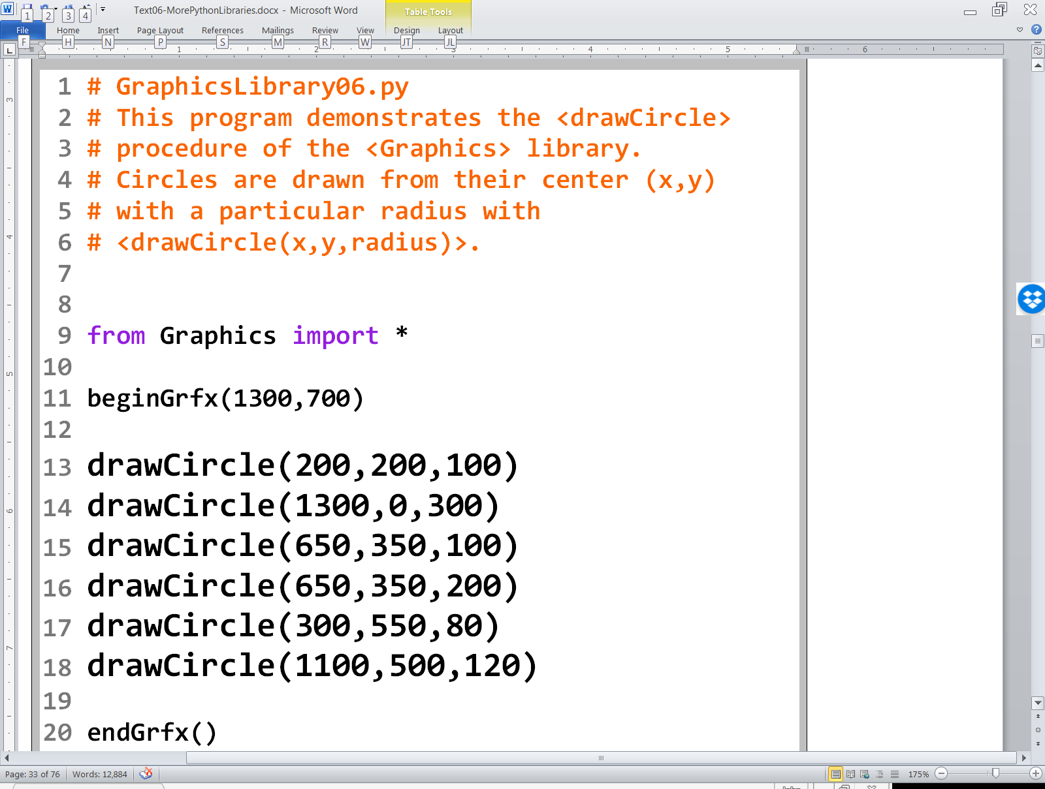

Slide 26
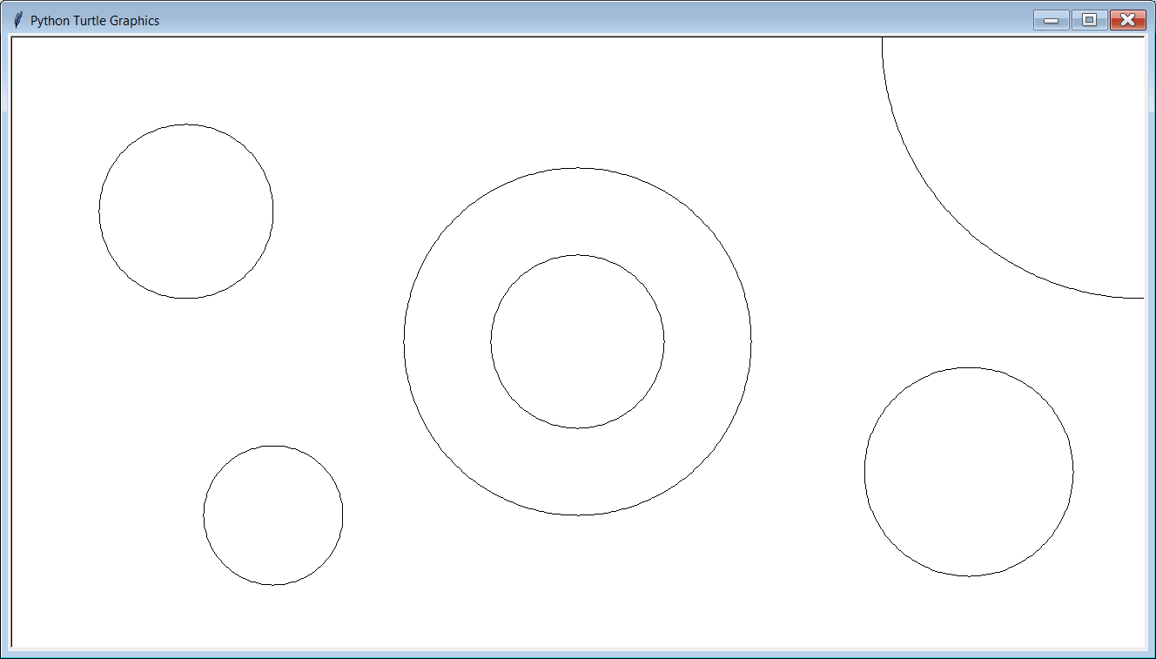

Slide 27
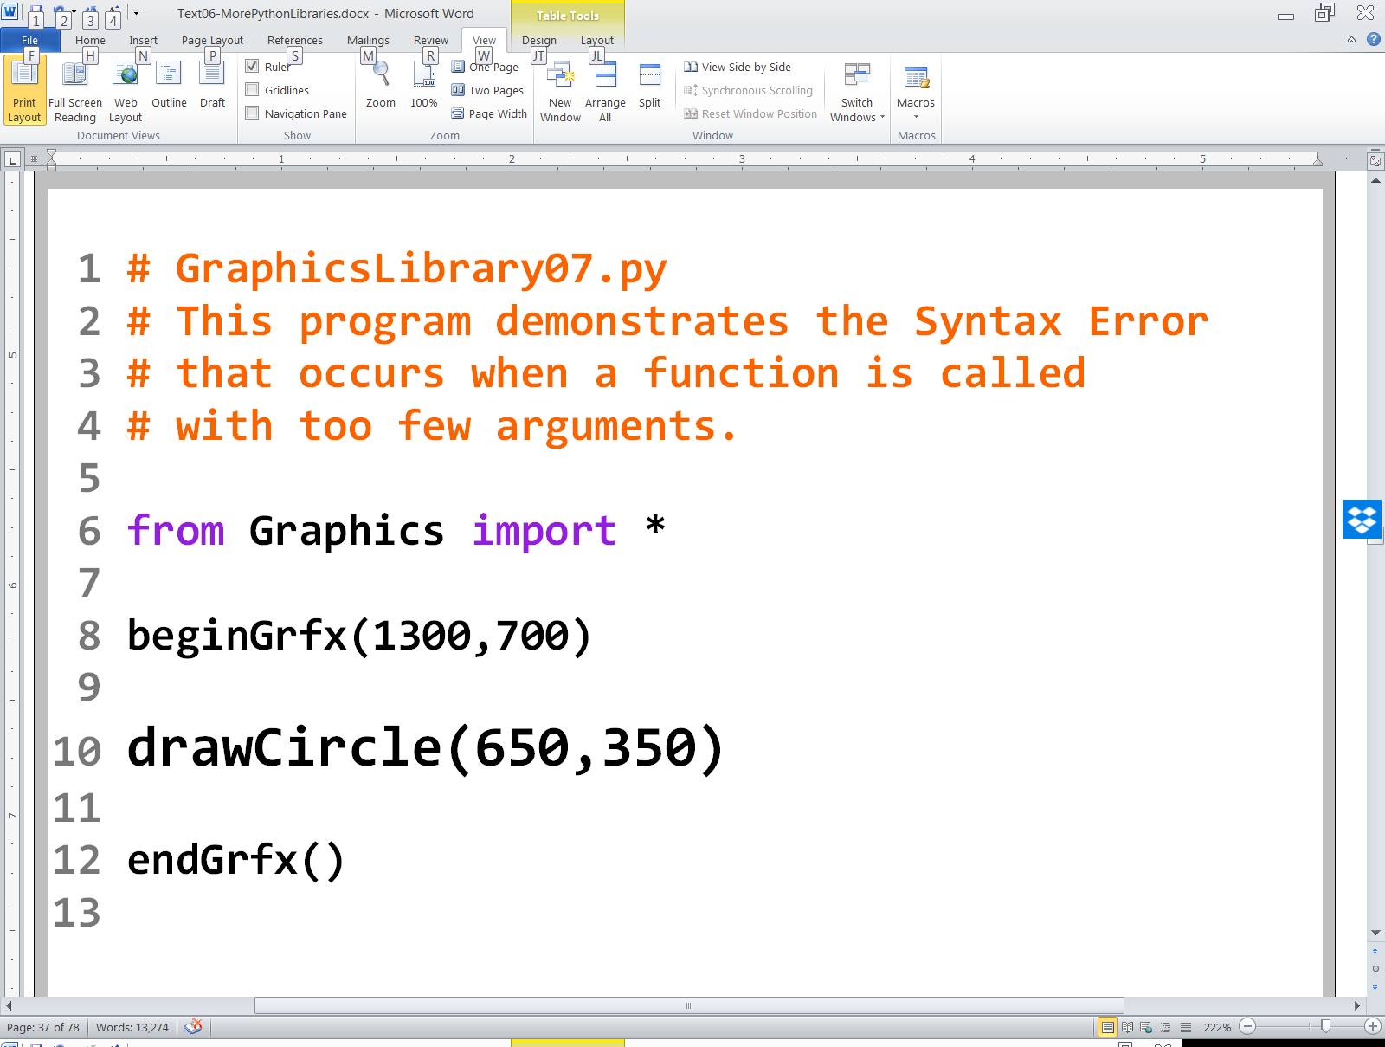

Slide 28
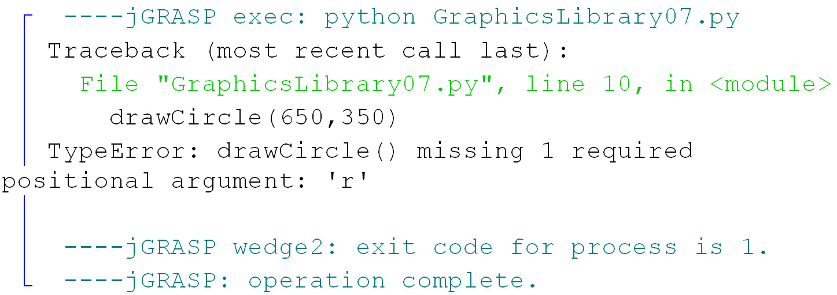

Slide 29
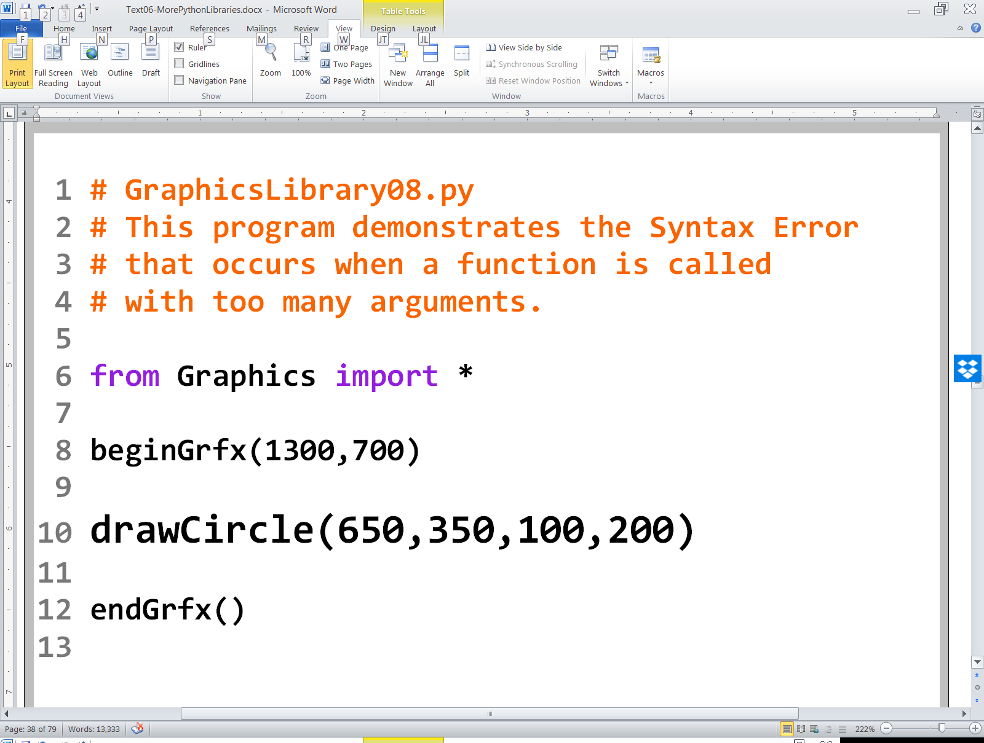

Slide 30
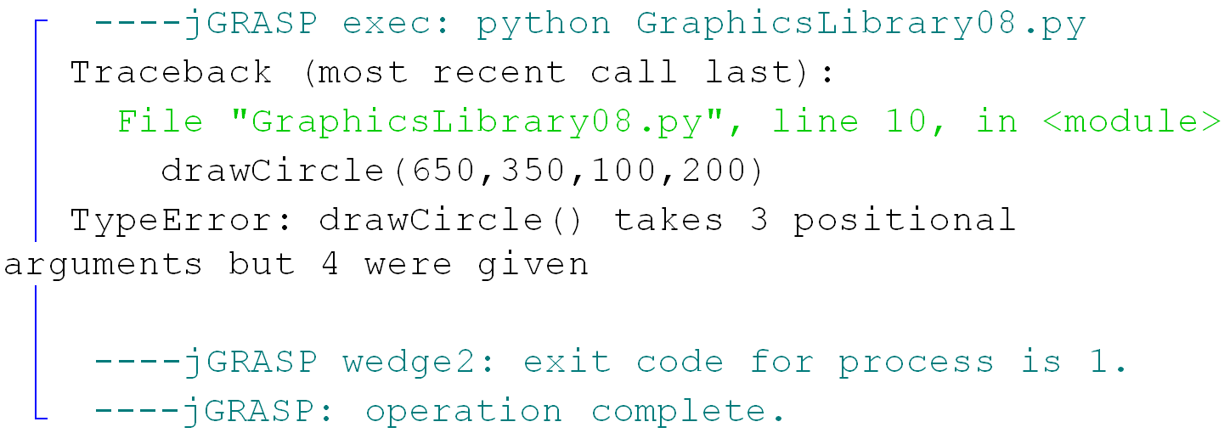

Slide 31
Procedure drawOval
drawOval(centerX, centerY, horizontalRadius, verticalRadius)
The location of the oval is specified in its center (centerX,centerY) and the size is specified by the 2 radii.
centerX, centerY
v radius
h radius

Slide 32
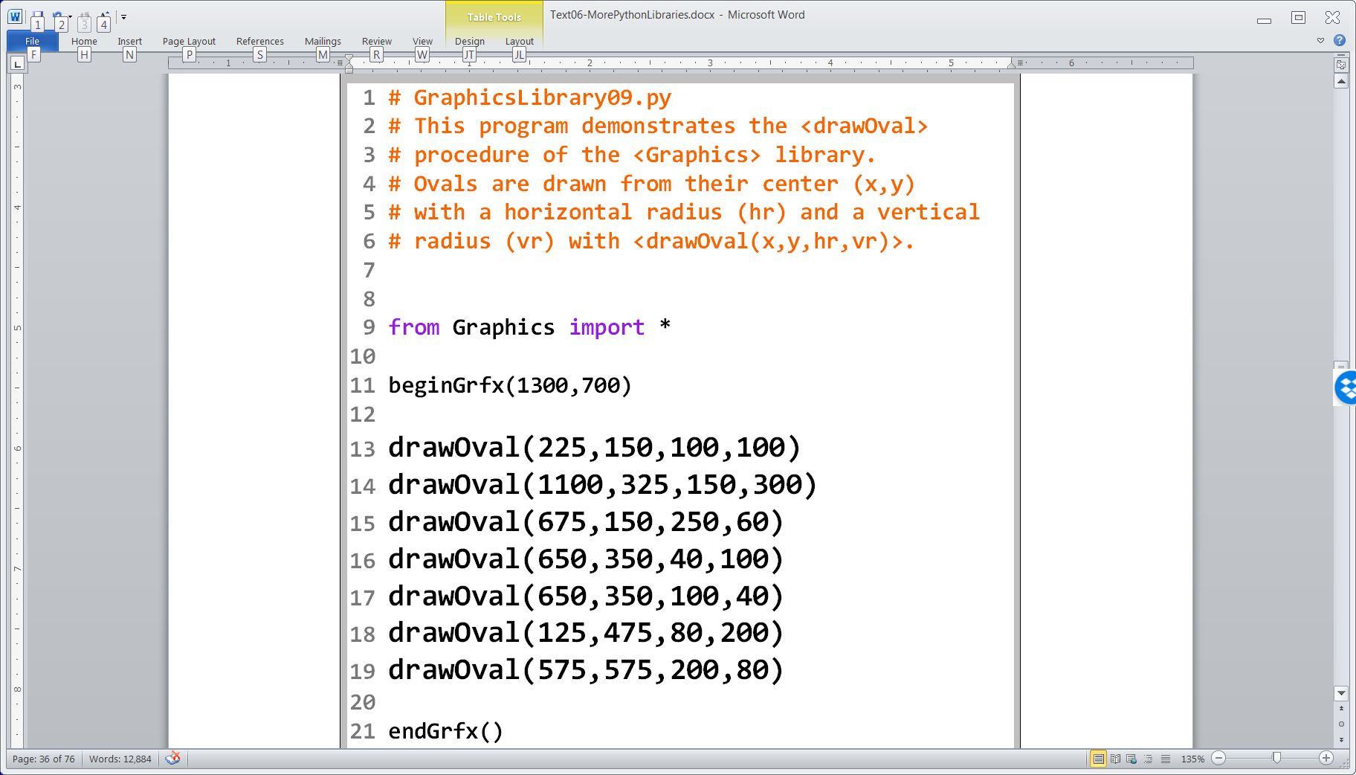

Slide 33
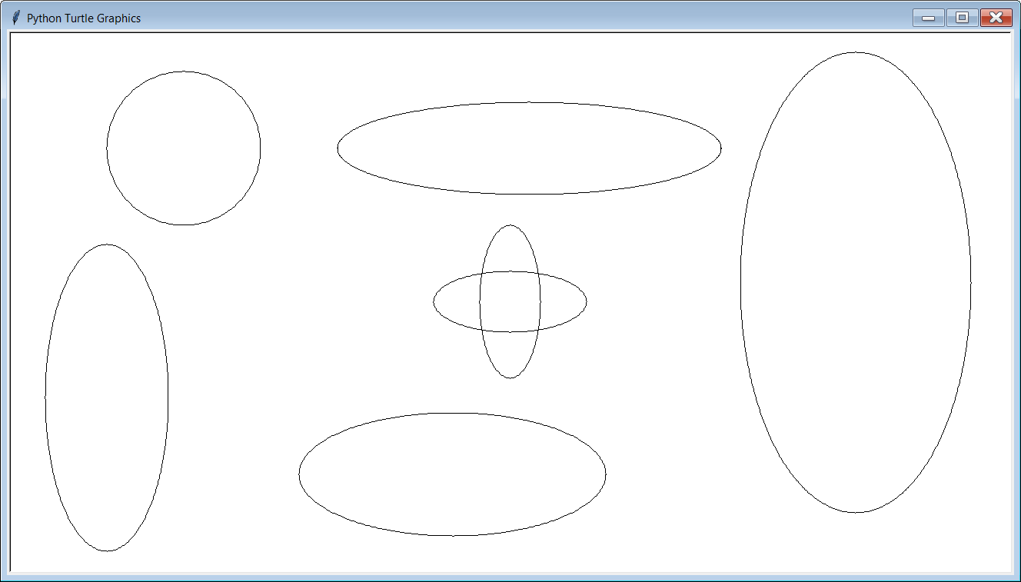

Slide 34

Drawing Arcs
0°, 360°
An arc is a piece of an oval.
In order to draw an “arc” you need specify where the arc starts and where it stops.
330°
30°
300°
60°
270°
90°
240°
120°
210°
150°
180°

Slide 35
Procedure drawArc
drawArc(centerX, centerY, horizontal radius, vertical radius, start, finish)
Draws part of an oval. The first 4 arguments are the same as drawOval.
start indicates the degree location of the beginning of the arc.
finish indicates the degree location of the end of the arc.
centerX, centerY
v radius
start
h radius
finish

Slide 36
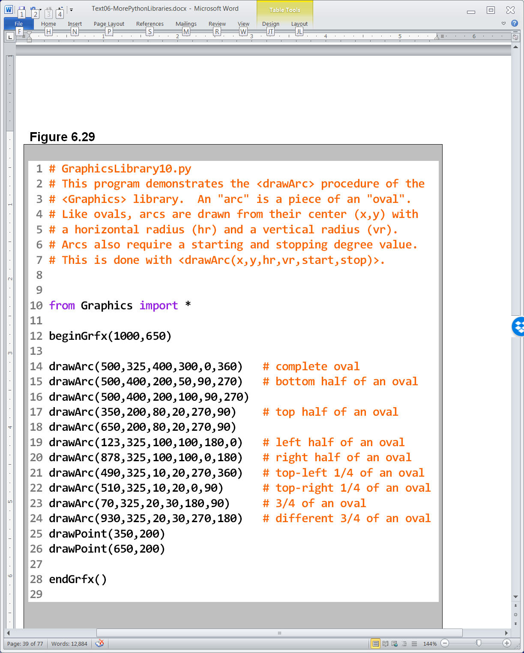

Slide 37
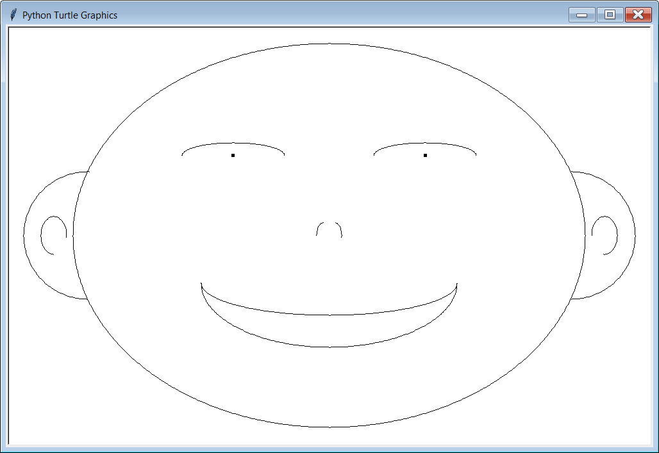

Slide 38
Argument Sequence Again
drawArc(centerX, centerY, horizontal radius, vertical radius, start, finish)
Argument sequence is VERY significant !!!!!!!
Simply switching the order of the start and finish arguments causes a completely different arc to be drawn.
The next program will graphically demonstrate what happens when arguments are out of order.
centerX, centerY
finish
h radius
v radius
start

Slide 39
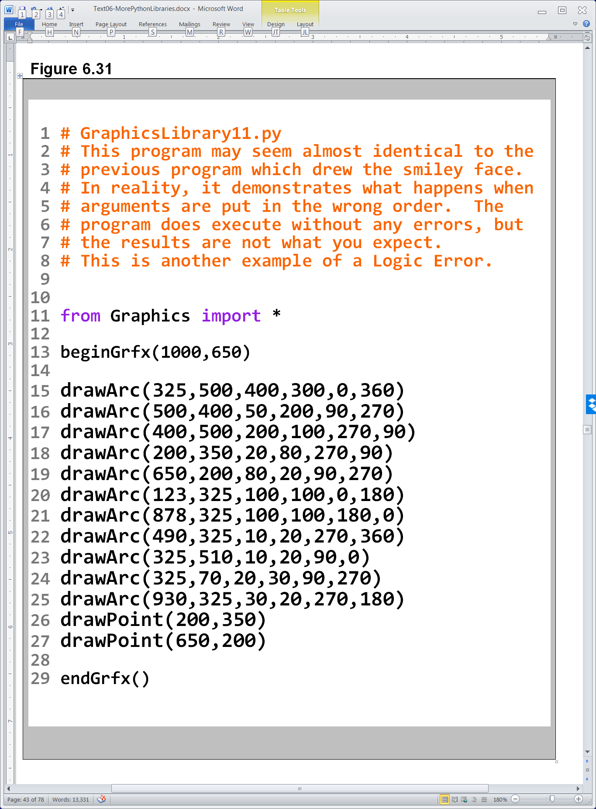

Slide 40
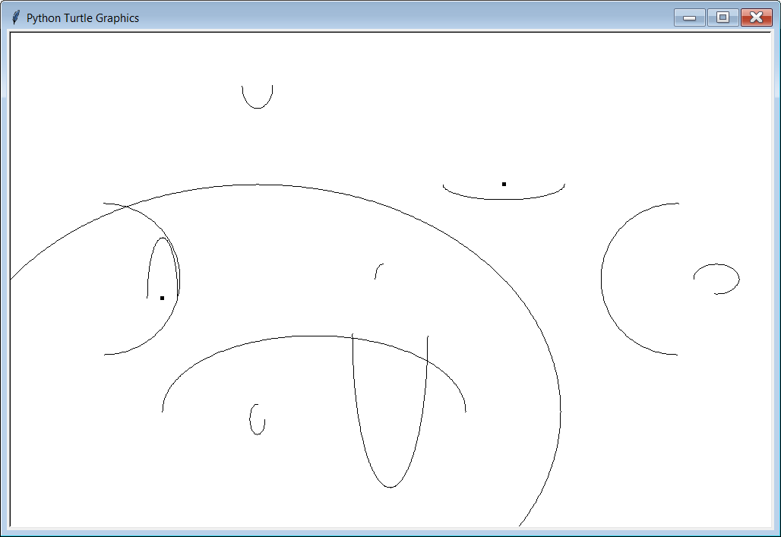

Slide 41
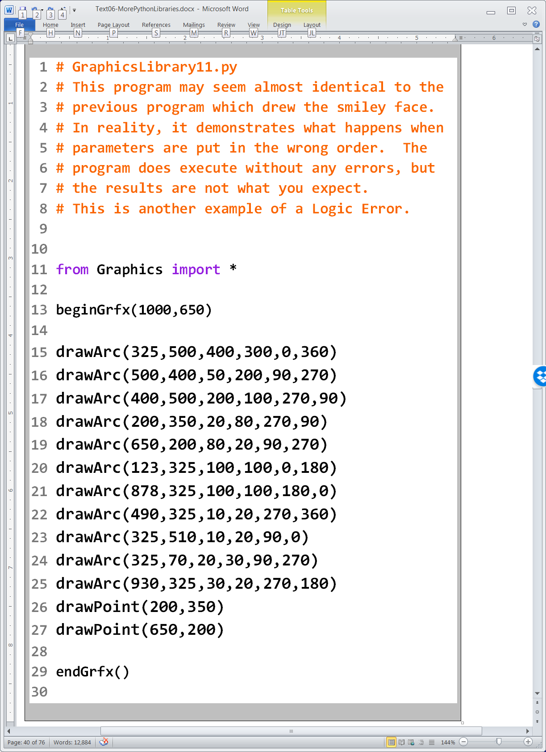
Argument Sequence Matters GraphicsLibrary10.py vs. GraphicsLibrary11.py

Slide 42
Section 6.6
Drawing
Polygons

Slide 43
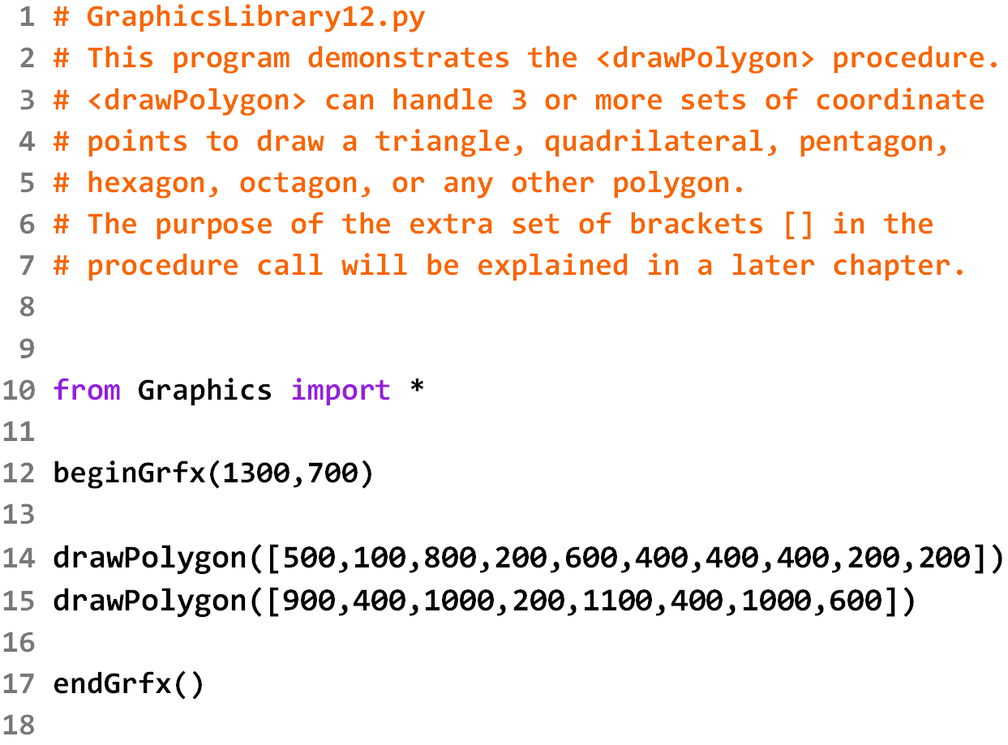

Slide 44
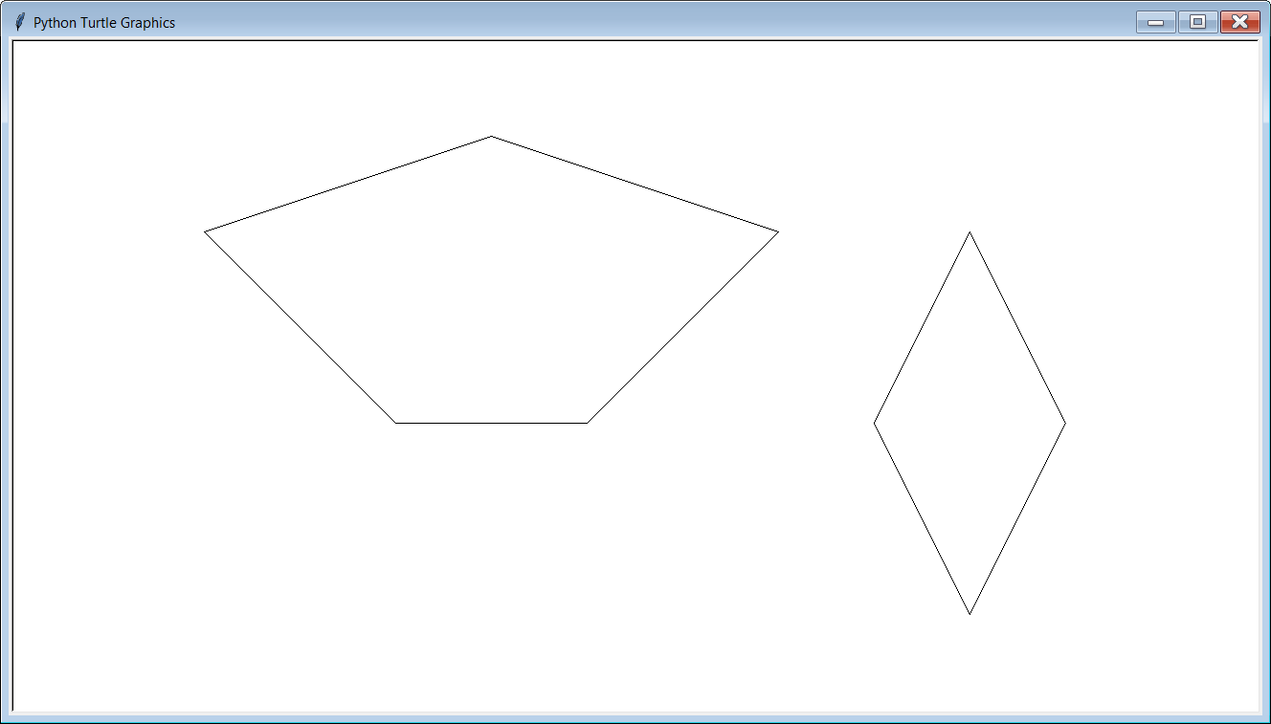

Slide 45
500,100
200,200
800,200
400,400
600,400

Slide 46
1000,200
900,400
1100,400
1000,600

Slide 47
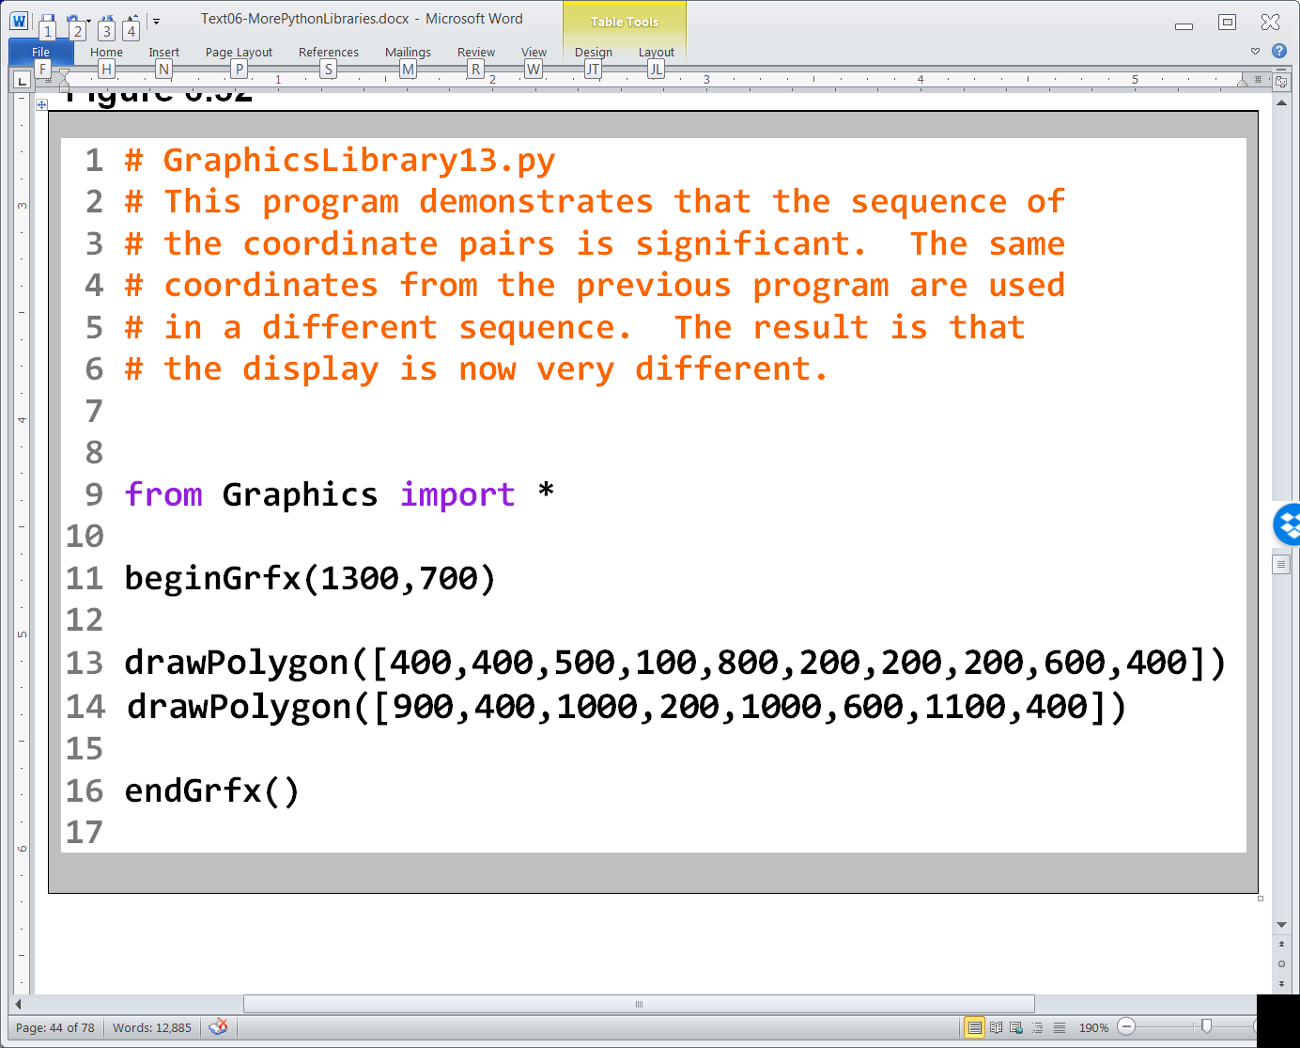

Slide 48
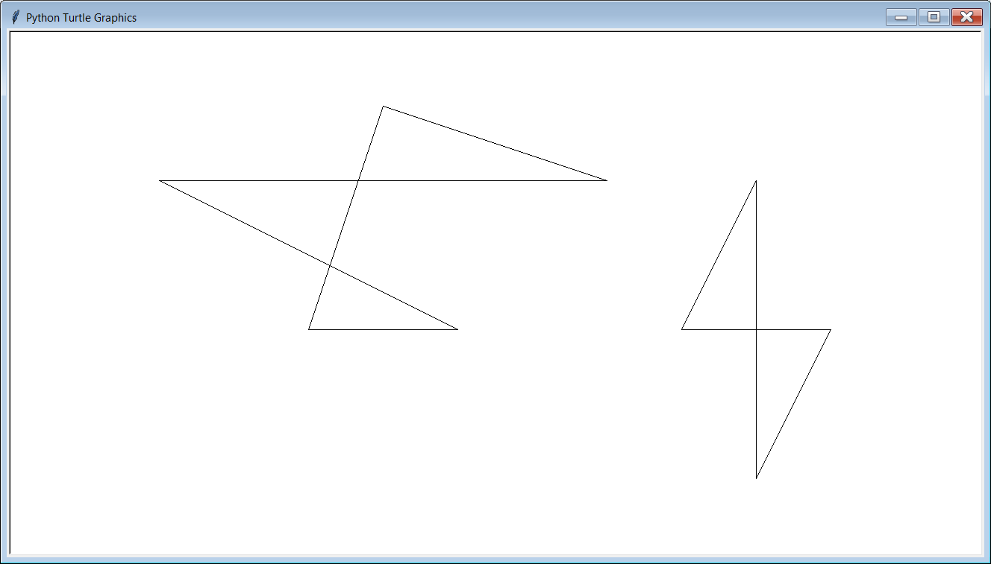

Slide 49
500,100
200,200
800,200
400,400
600,400

Slide 50
1000,200
900,400
1100,400
1000,600

Slide 51
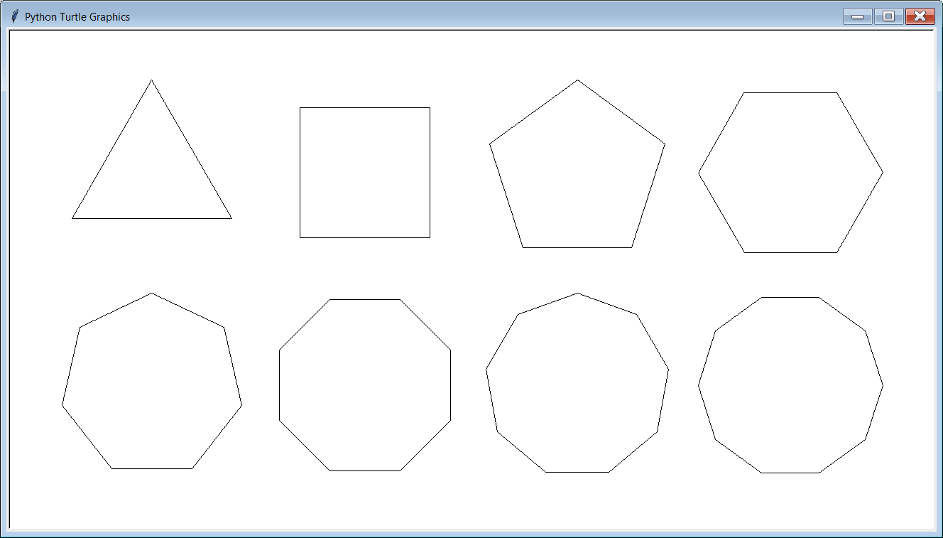


Procedure drawRegularPolygon
drawRegularPolygon(centerX, centerY, radius, numSides)
The first 3 arguments for drawRegularPolygon are the same as drawCircle.
The last argument indicates the number of sides.
centerX, centerY
radius

Slide 52
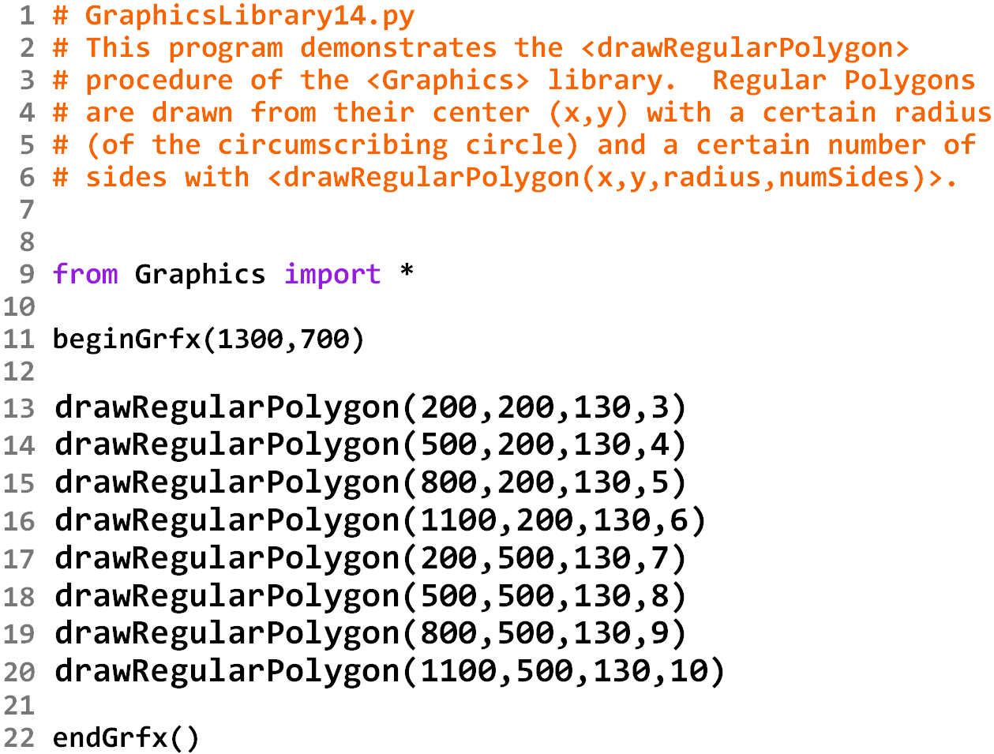

Slide 54
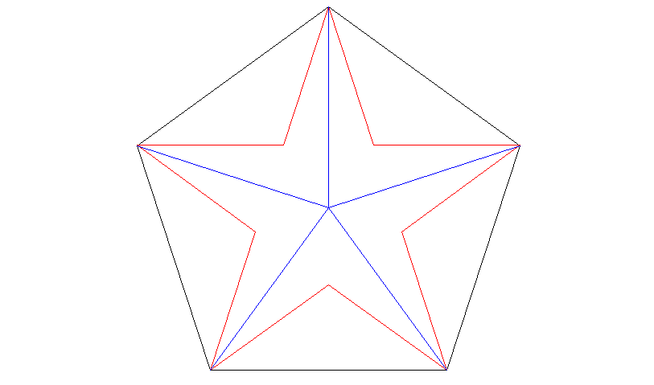
Special Regular Polygons
To me, stars and snowflakes are special kinds of regular polygons. Below you can see that a 5-point star and a 5-point snowflake both fit perfectly inside a 5-sided regular polygon.
radius

Slide 55
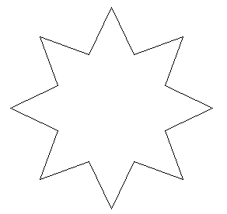



Procedure drawStar
drawStar(centerX, centerY, radius, numPoints)
The first 3 arguments for drawStar are the same as drawCircle.
The last argument indicates the number of points.
centerX, centerY
radius

Slide 56
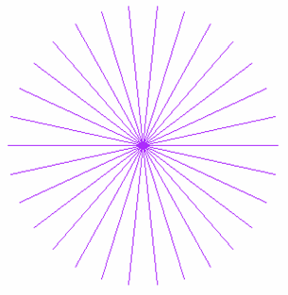
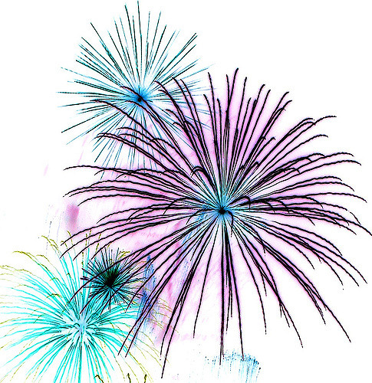

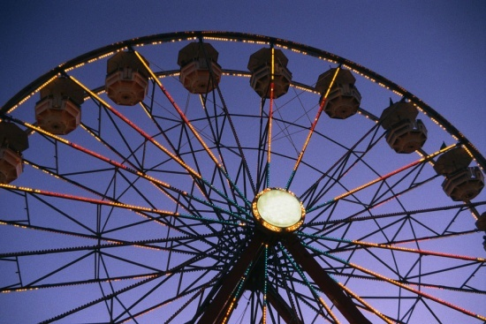
Procedure drawBurst
drawBurst(centerX, centerY, radius, numLines)
The first 3 arguments for drawBurst are the same as drawCircle.
The last argument indicates the number of lines.
centerX, centerY
radius

Slide 57
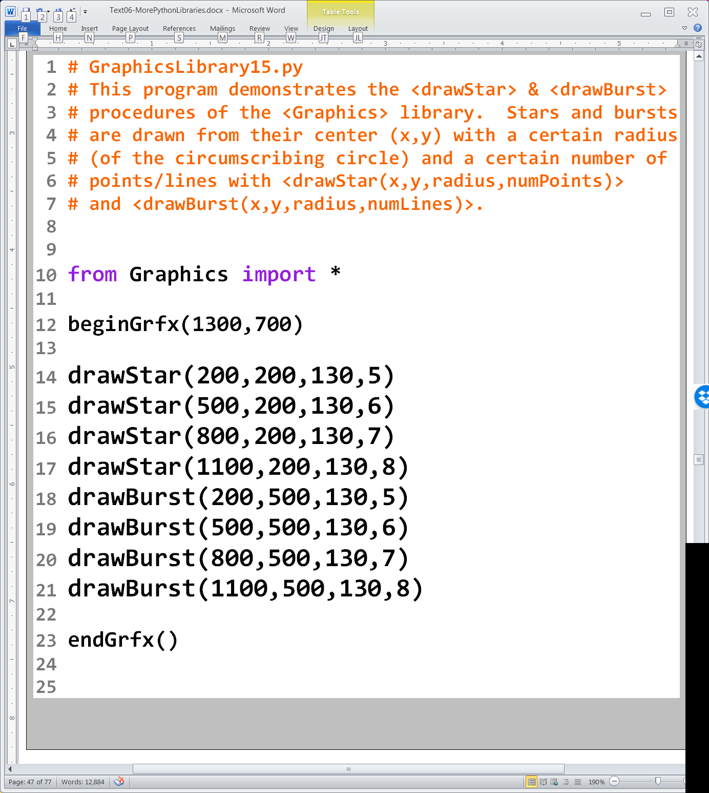

Slide 58
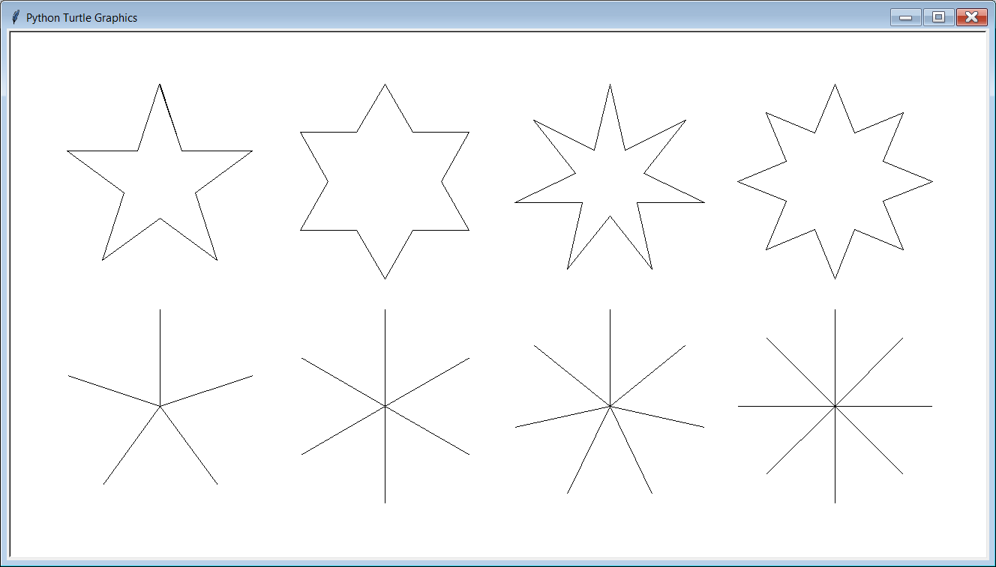

Slide 59
Section 6.7
Fill Procedures
and Colors

Slide 60
Procedure fillRectangle
fillRectangle(x1, y1, x2, y2)
Draws a SOLID (filled in) rectangle with a top-left corner at coordinate (x1,y1) and a bottom-right hand corner of (x2,y2).
x1, y1
x2, y2

Slide 61
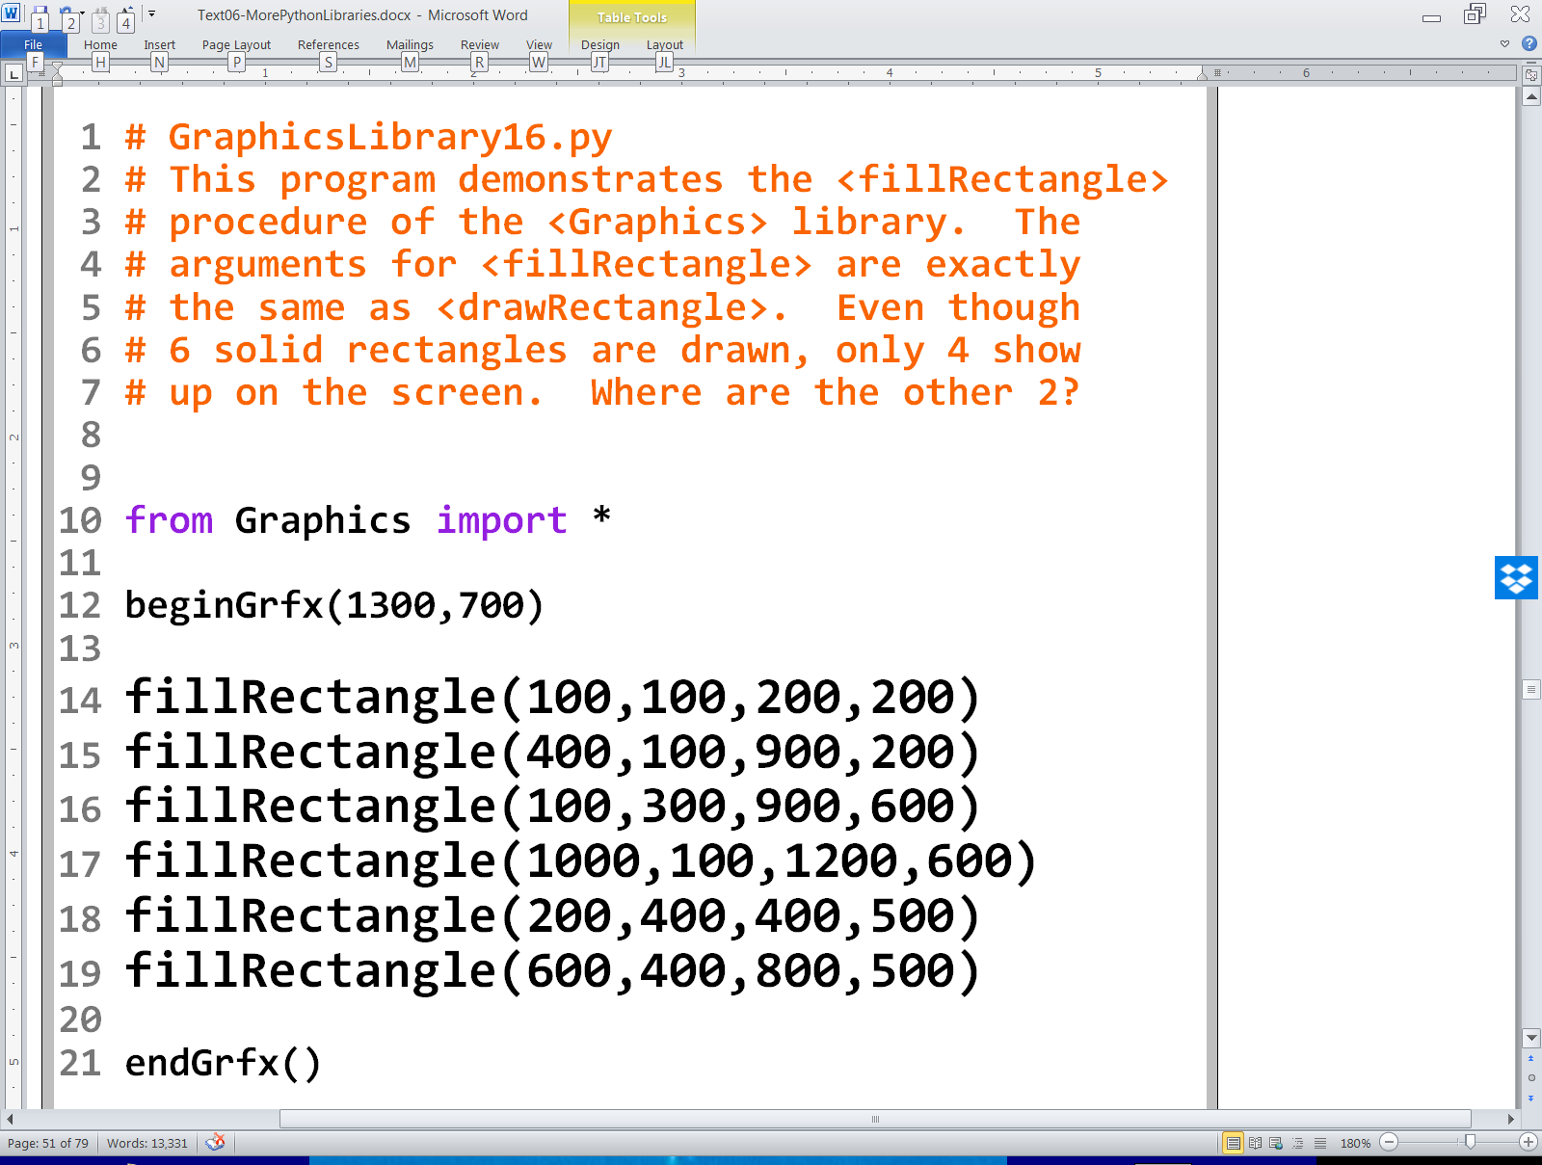

Slide 62
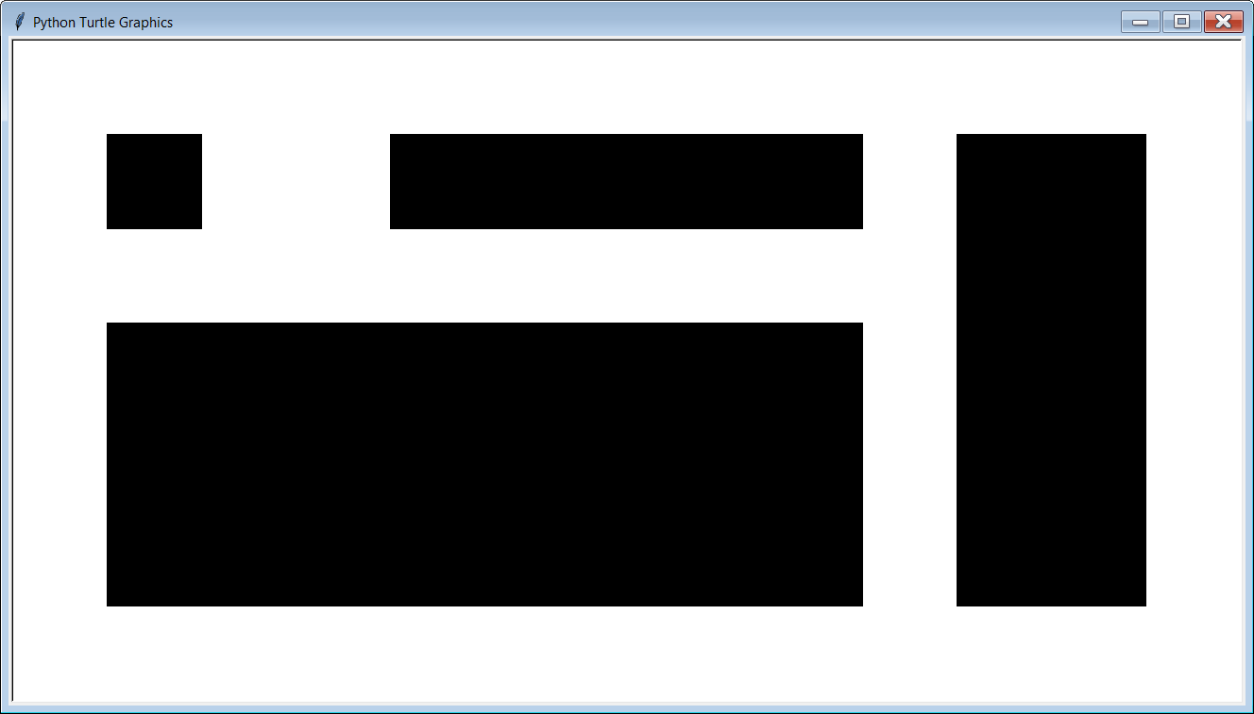




Slide 63
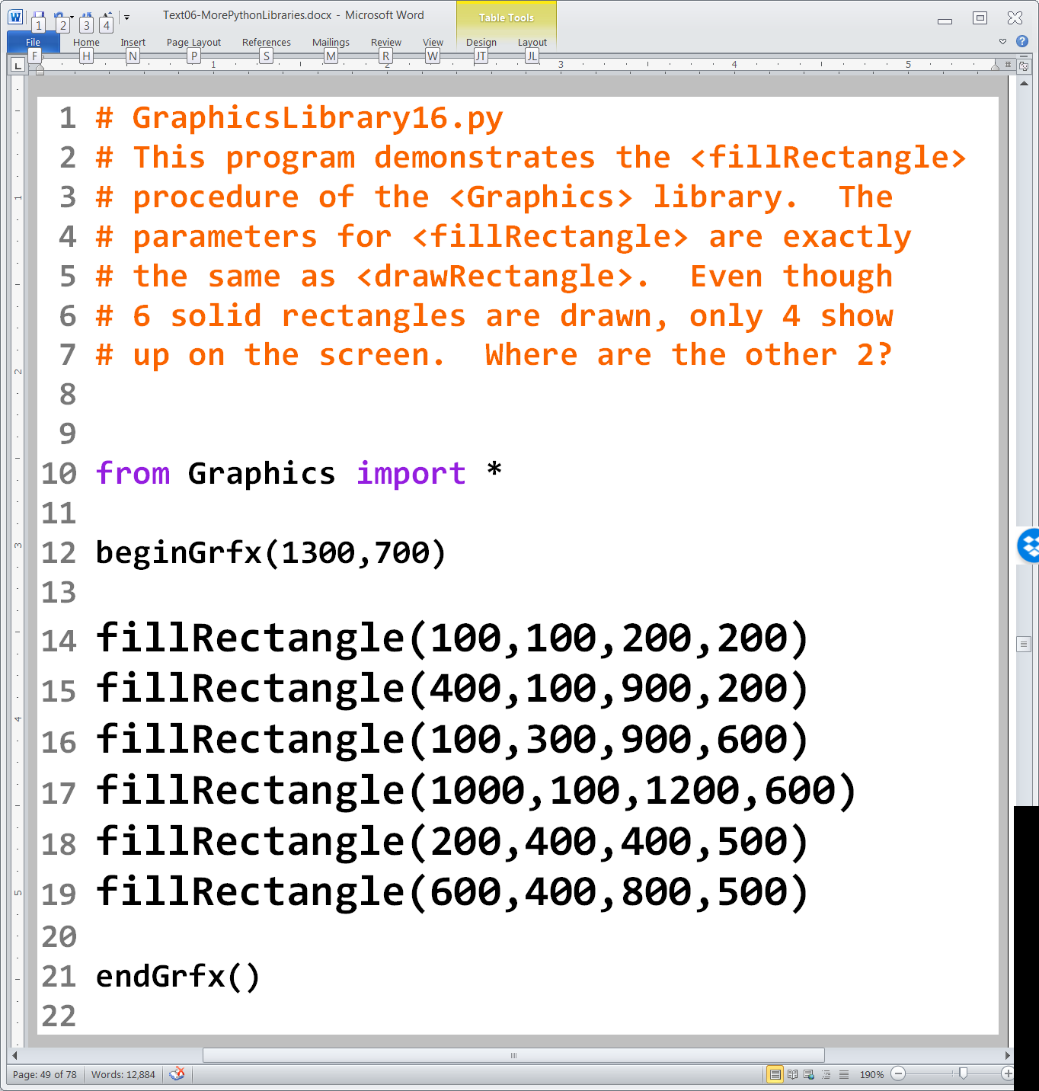
drawRectangle & fillRectangle GraphicsLibrary03.py vs. GraphicsLibrary16.py
These 2 rectangles do not show up when filled because they are the same color as the rectangle behind them.

Slide 64
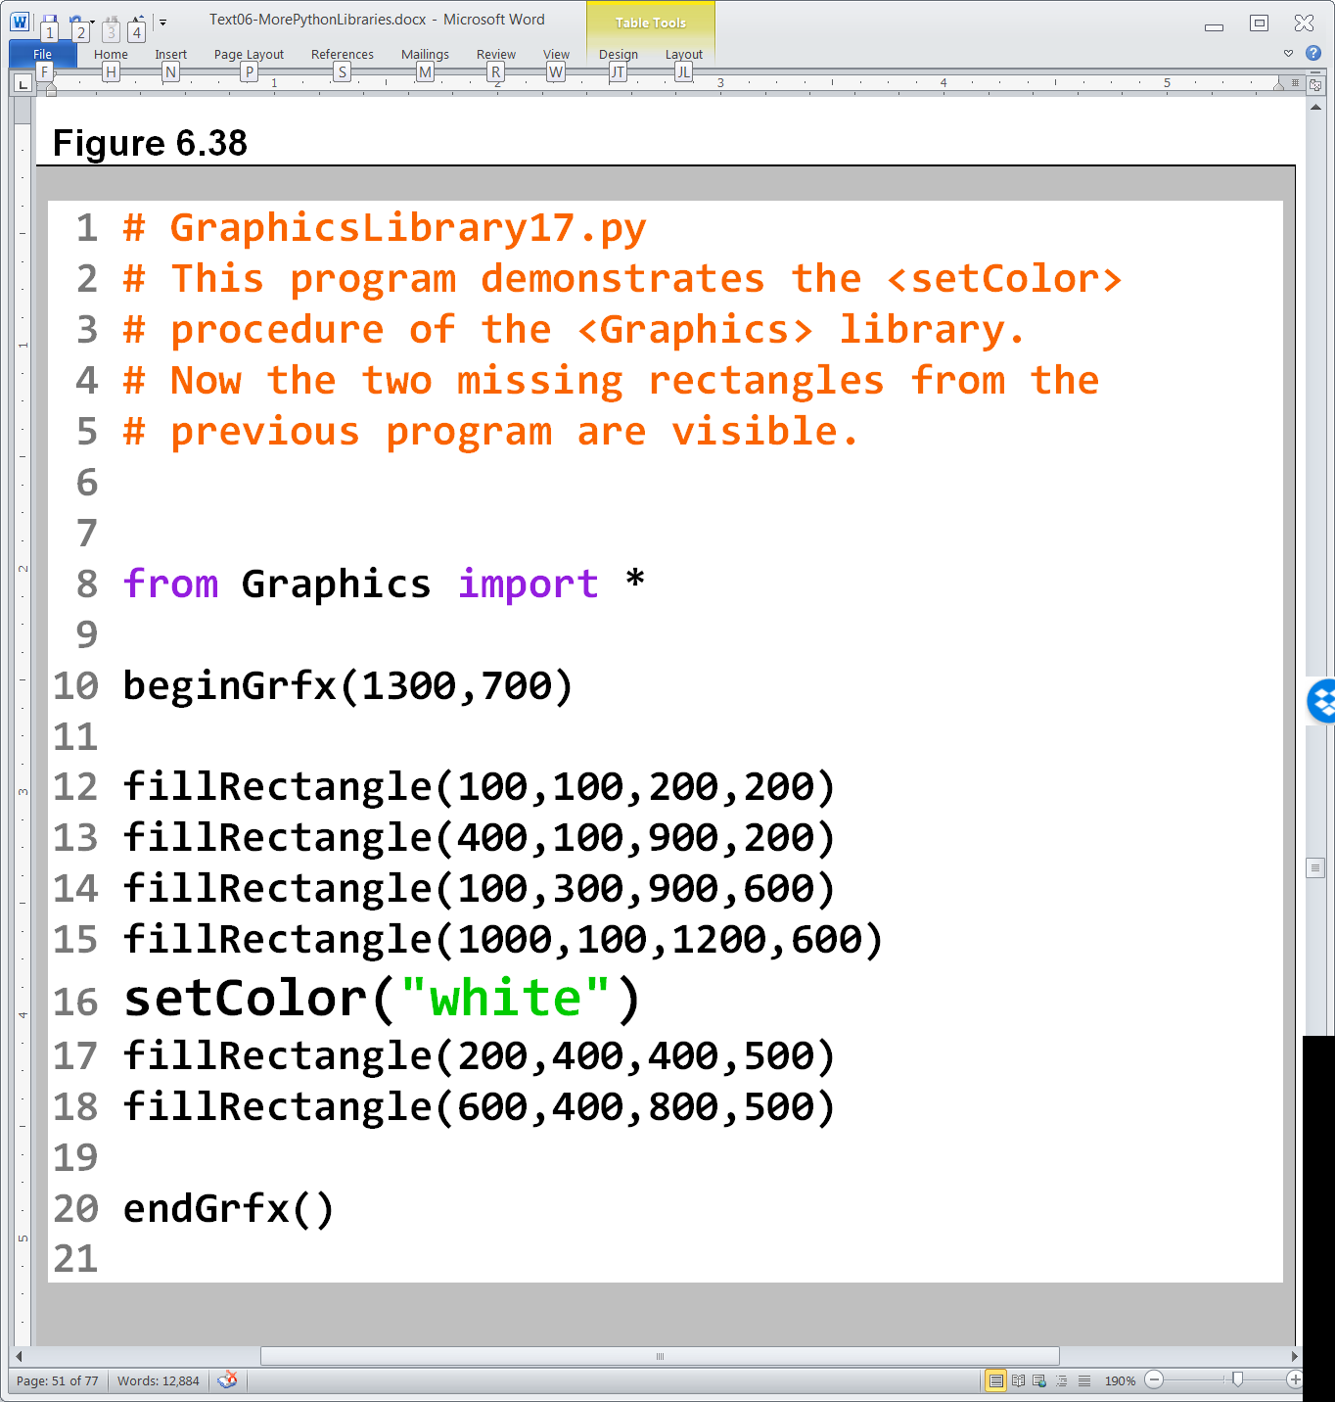

Slide 65
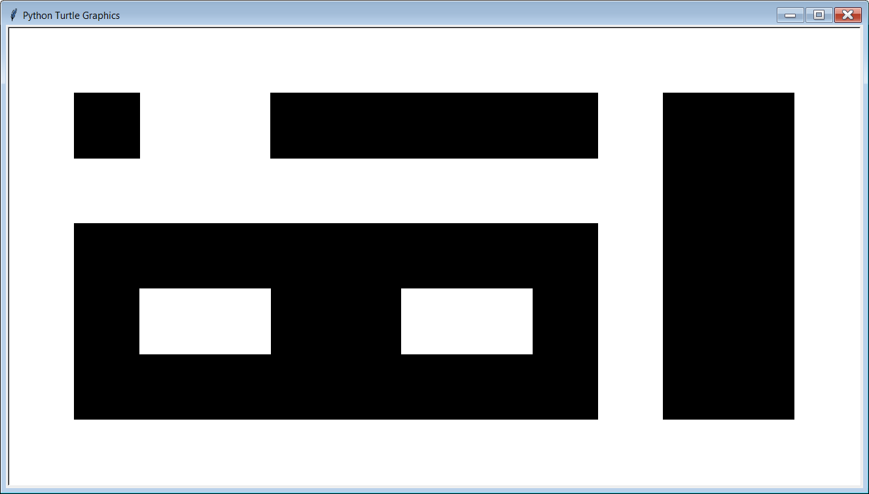

Slide 66
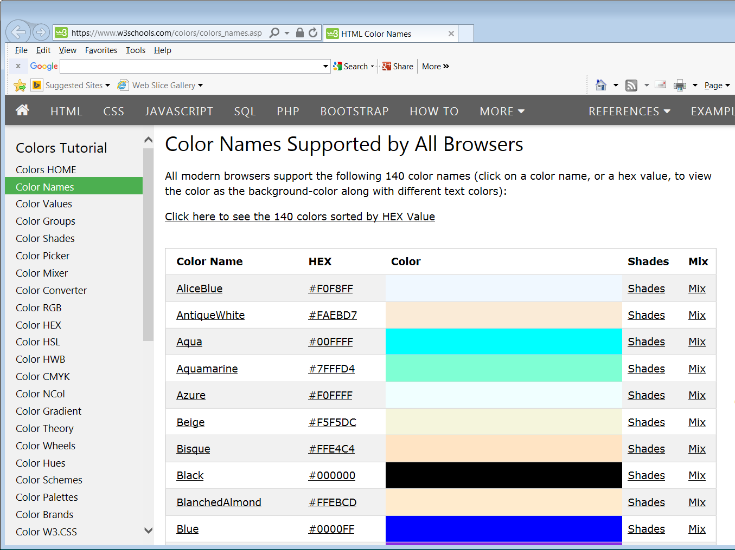
The 140 colors available in Python are listed here:
https://www.w3schools.com/colors/colors_names.asp
NOTE: Some of these colors, like Aqua, do not work in Python when using a Mac.

Slide 67
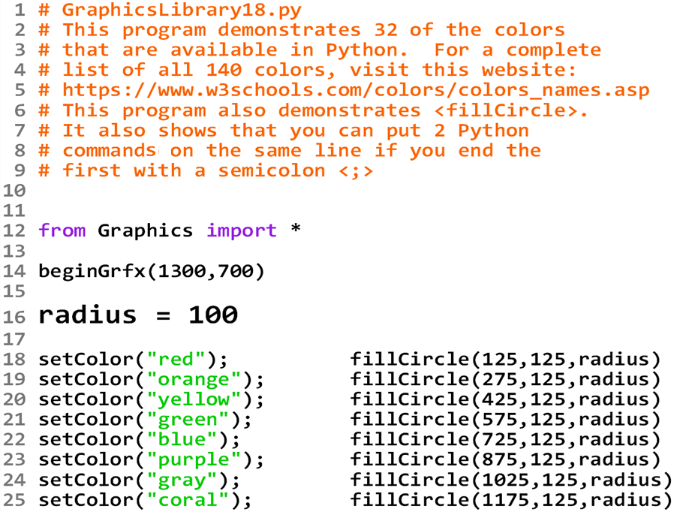

Slide 68


Slide 69

GraphicsLibrary18.py Current output with radius = 100

Slide 70

GraphicsLibrary18.py Output if radius = 50

Slide 71

GraphicsLibrary18.py Output if radius = 150

Slide 72


Slide 73


Slide 74


Slide 75


Slide 76


Slide 77



Slide 78



Slide 79



Slide 80



Slide 81
Section 6.8
Graphics Library
Reference Information

Slide 82

Graphics Library Reference (Location)

Slide 83

Graphics Library Reference (Legal Stuff)

Slide 84

Graphics Library Reference (First Few Procedures)

Slide 85

Things to Remember about the Graphics Library

